Slide 1
Chronic Absenteeism
Aveene Coleman, Office of Student Support
September 5, 2023
Notes:
Just type in the content placeholder to add your title.

Slide 2
Chronic Absenteeism and Truancy
Chronic Absenteeism | Truancy
Chronically absent: Any student in grade K-12 who misses 50 percent or more of the instructional day for any reason for 10 percent (or more) of the enrollment period. • All types of absences contribute to chronic absenteeism: – Excused Absences – Unexcused Absences – Suspensions • A student is absent if he or she is not physically on school grounds and is not participating in instruction or instruction-related activities at an approved off-grounds location for at least half the school day. | Truant: A student between the ages 6– 17 who has accumulated unexcused absences on three consecutive days or has accumulated a total of five or more unexcused absences during the academic year. • Only full-day unexcused absences contribute to truancy. • Excused absences and suspensions do not affect truancy

Slide 3
Chronic Absenteeism Data
*Pandemic year – schools closed in March 2020
Notes:
Note that the numbers are still trending higher for this year.

Slide 4
Chronic Absenteeism Data 2021-22
Notes:
Note that the numbers are still trending higher for this year.

Slide 5
2020-21and 2021-22 Chronic Absences Data

Slide 6
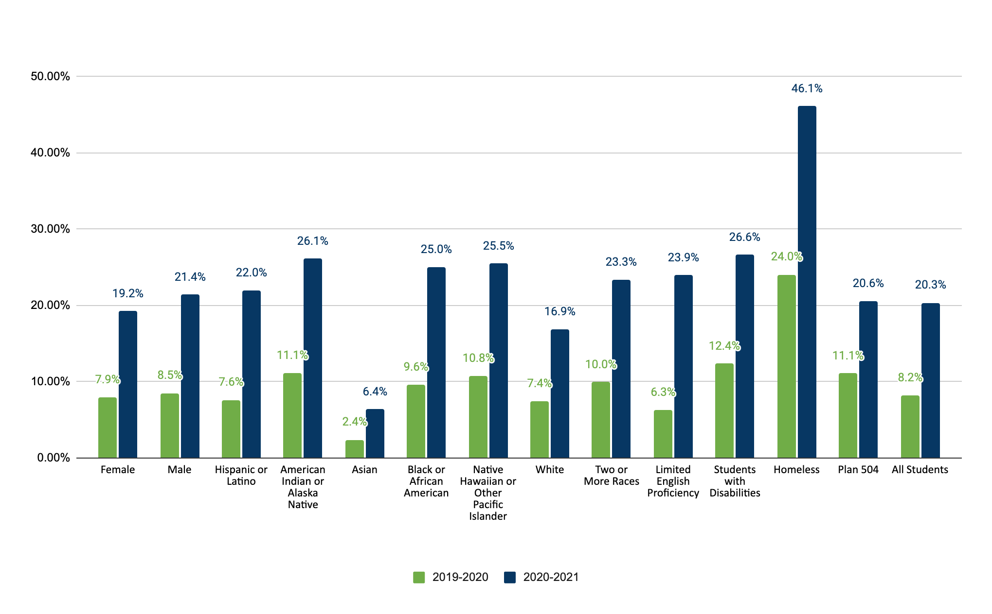
Chronic Absenteeism Data 2019-20-2020-21

Slide 7
Chronic Absenteeism
The 10 percent is based on the individual student’s enrollment
40 days enrolled= 4 days absent
90 days enrolled= 9 days absent
130 days enrolled= 13 days absent
180 days enrolled =18 days absent

Slide 8
Chronic Absenteeism Reporting
Excused Absences
Unexcused Absences
Suspensions
Chronic absenteeism reporting will include the following absences

Slide 9
Chronic Absenteeism-Report Card Reporting Requirements
Data will be reported at the school level
Grade Levels- K-12 (no age exemptions)
Students must be enrolled at least 10 days at any time during the school year to be reported as chronically absent
Data will be reported by:
  Gender
  Ethnicity/Race
  Disability Status
  504 Status
  ELL Status
  Homeless Status

Slide 10
Chronic Absenteeism-Report Card
Additional Reporting Elements on the School Report Card for Chronic Absenteeism
  Non-Economically Disadvantaged
  Economically Disadvantaged
  Migrant
  Non-Disabled
  Military Connected
  Foster

Slide 11
Chronic Absenteeism-Reporting
How should a student who enrolled at two schools, who is chronically absent at both during a school year be reported?
Students are reported once at each school. Example: If a student is enrolled in school A for half the school year (90 days) and school B for the other half of the school year (90 days). The student is counted at both school A and B as chronically absent.
How should a student who is absent that attends school part-time be reported?
The absence for a part-time student should be based on the student’s schedule instead of the school day. For example, if a student attends school normally for 4 hours daily, then an absence would be counted when a student is out of school two or more hours.

Slide 12
Attendance Codes Update
No New Attendance Codes for 2023-24
No changes to the following codes for the 2023-24 school year
  SC-COVD
  SC-VTP
Attendance Code Review
  Medical Homebound Attendance Code-SC-HMBD
  Homebased Attendance Code-SC-HBSD
  Attendance Recovery Code-SC-REC

Slide 13
Attendance Codes
Excused Parent Note-SC-PN
Unexcused Parent Note-SC-UEPN

Slide 14
Approval of Absences in Excess of Ten Days
Approval of Absences in Excess of Ten Days and Approval of Credit (A) Approval or Disapproval of Absences The district board of trustees, or its designee, shall approve or disapprove any student’s absence in excess of ten days, whether lawful, unlawful, or a combination thereof, for students in grades K-12. For the purpose of awarding credit for the year, school districts must approve or disapprove absences in excess of ten days regardless as to whether those absences are lawful, unlawful, or a combination of the two.
SBE Regulation 43-274:Student Attendance (Absences and Excuses) (sc.gov)

Slide 15
Student Attendance-High School Credit
(B) High School Credit In order to receive one Carnegie unit of credit, a student must be in attendance at least 120 hours, per unit, regardless of the number of days missed, or must demonstrate proficiency as determined by the local school district. This exception to the 120-hour requirement is to be administered by local school districts on a case-by-case basis and only for students who have excessive absences that have been approved by the local school board. General request for proficiency-based credit must be made through the process described in Regulation 43-234. Students whose absences are approved should be allowed to make up any work missed in order to satisfy this requirement. Local school boards should develop policies governing student absences giving appropriate consideration to unique situations that may arise within their districts when students do not meet the minimum attendance requirements. Therefore, districts should allow students, whose excessive absences are approved in part 1 of this section, to make-up work missed to satisfy this requirement.

Slide 16
Chronic Absenteeism Scenario
The student misses the following days:
  5 days unexcused
  5 days out of school suspension
  5 days excused
  3 days the student did not attend 50 percent of their scheduled school day
Will the student be reported as chronically absent?
Yes
No

Slide 17
SCDE Standardized Attendance Codes
Description | Presence Status | Code | Code Category
Present | Present | Blank | Present
Unexcused/Unverified | Absent | SC-UNEX | Unexcused
Excused | Absent | SC-EX | Excused
Principal Approved | Absent | SC-PA | Excused
Medical | Absent | SC-MED | Excused
Flu-Influenza | Absent | SC-FLU | Excused
Parent Note | Absent | SC-PN | Excused
Unexcused Parent Note | Absent | SC-UEPN | Unexcused
Immunization | Absent | SC-IMNZ | Excused/Unexcused
Administrative Hearing | Absent | SC-AH | Excused
Excused Tardy | Present | SC-ETRD | Tardy
Bus Tardy | Present | SC-TRD | Tardy
Unexcused Tardy | Present | SC-UTRD | Tardy
Homebound | Present | SC-HMBD | Present
Homebased Instruction | Present | SC-HBSD | Present
Field Trip/School Activity | Present | SC-FT | Present

Slide 18
SCDE Standardized Attendance Codes (cont.)
Description | Presence Status | Code | Code Category
Religious | Absent | SC-REL | Excused
Out of School Suspension (OSS) | Absent | SC-OSS | OSSusp
Weather | Absent | SC-WTHR | Excused
Legal/Court | Absent | SC-LEG | Excused
College Visit | Present | SC-COL | Present
Attendance Recovery/ Saturday Recovery | Absent | SC-REC | Excused
On Site Services | Present | SC-ONST | Present
In School Suspension (ISS) | Present | SC-ISS | Present
Bereavement/Death in Family | Absent | SC-BRV | Excused
Dismissal | Absent | SC-DSML | Excused/Unexcused
Early Dismissal | Present | SC-EDSM | Present
Unexcused Early Dismissal | Present | SC-UEDM | Present
Check-In | Present | SC-CKIN | Present
Skip | Absent | SC-SKIP | Unexcused
Late | Absent | SC-LATE | Unexcused
Nurse | Absent | SC-NURS | Excused
Virtual Present | Present | SC-VTP | Present
COVID | Absent | SC-COVD | Excused
Kindergarten Staggered Start | Present | SC-KTST | Present

Slide 19
Chronic Absenteeism Scenario 1
A student who is signed out early but did not attend 50 percent of the school day (DA) or the student’s scheduled day (MA).
SC-EX
SC-EDSM
SC-DSML
SC-UEDM
None of the Above
Will this day count towards chronic absenteeism? Yes or No

Slide 20
Chronic Absenteeism Scenario 2
A student who is absent and submits a parent note.
SC-PN
SC-EX
SC-UEPN
SC-UEDM
A or C
Will this day count towards chronic absenteeism? Yes or No

Slide 21
Chronic Absenteeism Scenario 3
A student who is sent home sick by the nurse but did not meet the 50 percent of the day.
SC-EX
SC-NURS
SC-DSML
SC-UEDM
None of the Above
Will this day count towards chronic absenteeism? Yes or No

Slide 22
Chronic Absenteeism Scenario 4
A student who is suspended from school all day or 50 percent or more of the school day.
SC-DSML
SC-OSS
SC-EX
SC-UEDM
None of the Above
Will this day count towards chronic absenteeism? Yes or No

Slide 23
Attendance Codes
Early Dismissal (SC – EDSM) - this code should be used if the student has attended 50% or more of the school day and is leaving early. This is a present code.
Dismissal (SC–DSML) - this code should be used if a student has attended less 50 percent of the school day. This is an absent code.
Check-In (SC-CKIN)-this code should be used if a student leaves school for an appointment and returns to school. The student must have attended school for 50% or more of the school day. This is a present code.
Skipping Class Code (SC-SKIP)- this code should be used if the student is deliberately not attending class without parent or school approval. This is an unexcused absent code.
Late (SC-LATE)-this code should be used if a student is extremely late to school, without an excuse. The student attended less 50 percent of the school day. This is an unexcused absent code.

Slide 24
Attendance Codes Reminders-(SC-COVD)
Attendance Code: SC-COVD (excused absence)
Students who are not physically present due to COVID-19 (isolation or quarantine) and are unable to complete assignments should be marked absent using the established COVID code.

Slide 25
Attendance Coding 2
Scenario | Attendance Coding | Special Program Coding
A student is impacted by COVID and is assigned to virtual instruction or received an educational packet. The student submits assignments and/or participates in learning activities. | SC-VTP (present) | TMPVIR

Slide 26
Attendance Coding 3
Scenario | Attendance Coding | Special Program Coding
The entire classroom is moved to virtual. The student submits assignments as required. (COVID related) | SC-VTP (present) | TMPVIR

Slide 27
DHEC’s Guidance Documents for COVID
Staying Home from School or Childcare When Your Child is Sick
COVID-19 is on DHEC’s School Exclusion List with the following information:
Coronavirus Infectious Disease 2019 (COVID-19) Children with a positive COVID-19 test should stay home until they have had no fever for 24 hours without the use of fever reducing medication AND improvement of symptoms AND at least 5 days have passed since symptoms first appeared.

Slide 28
Virtual Attendance
Virtual attendance is determined by whether a student submits work or participates in assigned activities in accordance with the classroom teacher’s written requirements. Students who submit or participate in the assigned learning experience(s) by the deadline established by district policy should be considered present and coded Virtually Present (SC-VTP) in PowerSchool. Note: TMPVIR is marked in the special programs.
Students who fail to submit assignments or participate in the assigned learning experience(s) by the deadline established by district policy should be considered absent.

Slide 29
Chronic Absenteeism Scenarios
ATTENDANCE SCENARIOS | ATTENDANCE CODE | A COUNTS TOWARDS CHRONIC ABSENTEEISM | REVIEW DISTRICT ATTENDANCE POLICY
A student who is taking a test or involved in a school activity on campus. | SC-ONST or SC-FT | NO
A student who is receiving homebound instruction. | SC-HMBD | NO
A student who is receiving homebased instruction. | SC-HBSD | NO
A student who is absent because of a legal proceeding. | SC-LEG Or SC-EX | YES
A student who is absent and submits a parent note. | SC-PN Or SC UEPN | YES | X
A student who is absent for a Bereavement/Death in family. | SC-BRV | YES
A student who is absent attending a principal approved college visit. | SC-COL | NO
A student who is in In School Suspension. | SC-ISS | NO
A student who is suspended from school all day or 50 percent or more of the school day. | SC-OSS | YES
A student who is absent due to a religious holiday. | SC-REL | YES

Slide 30
Attendance Codes Reminders (SC-KTST)
Kindergarten and Pre-K Start Dates (Memo)
South Carolina Proviso 1A.62 (Kindergarten and Pre-K Start Dates) states: A district superintendent or charter school authorizer may submit a request to the department to waive the minimum one hundred eighty-day school attendance requirement for CERDEP and kindergarten students for the purpose of scheduling assessments. Upon approval of the waiver request, the approved school may stagger administering the assessments to CERDEP and kindergarten students during the first five days of the academic year.
Attendance Coding
  Students on campus-Present Code (Default)
  Students off campus-SC-KTST Code
Note: Districts with an approved waiver can use the SC-KTST Code.

Slide 31
Chronic Absenteeism-Taking Attendance
*Daily – Elementary School (1 period in Bell Schedule).-If a student leaves early, arrives late, or returns the Clock in and Clock out must be entered.
Meeting – Middle School, High School, Elementary School with more than 1 period in Bell Schedule. Attendance should be taken in every period. If the student leaves early, arrives late, or returns the attendance should be updated.

Slide 32
Chronic Absenteeism- Daily Attendance Schools (In-person)
Students attending 50% or more of the school day Attendance Codes (Daily Attendance)
Present
SC-EDSM*
SC-ETRD*
SC-UTRD*
SC-CKIN*
SC-FT
SC-HMBD, SC-HBSD, SC-ISS
SC-VTP (Virtual Attendance only)
* Clock in and Clock out is entered
Students attending less than 50 percent of the school day (Daily Attendance), but attended some portion of the school day.
Enter any absent Attendance Code + Clock in and Clock out
SC- DSML
SC-EX or SC UNEX
SC-MED
SC-LEG
SC-PN or SC UEPN
SC-LATE
SC-NURS

Slide 33
Virtual Learning Attendance
Students attending 50% or more of the school day Attendance
SC-VTP (Virtual Present)
* Clock in and Clock out is entered
Do not use the following codes in the virtual environment:
SC-EDSM
SC-ETRD
SC-UTRD
Students attending less than 50 percent of the school day but attended some portion of the school day.
Enter any absent code Attendance Code + Clock in and Clock out-Daily Attendance
Meeting Attendance (Any excused or unexcused code)
SC- DSML
SC-EX or SC UNEX
SC-MED
SC-LEG
SC-PN or SC UEPN
SC-LATE
SC-NURS
SC-COVD

Slide 34
Taking Daily Attendance
Entering an attendance for a student
Find and select the student.
Click on the Attendance page of the selected student.
On the Daily page for the Date you need to enter an attendance code, click on the character (M,T,W,H,F) of the day.
Select the appropriate Attendance Code from the drop down.
Leave Clock In and Clock Out blank.
Click Submit to save.

Slide 35
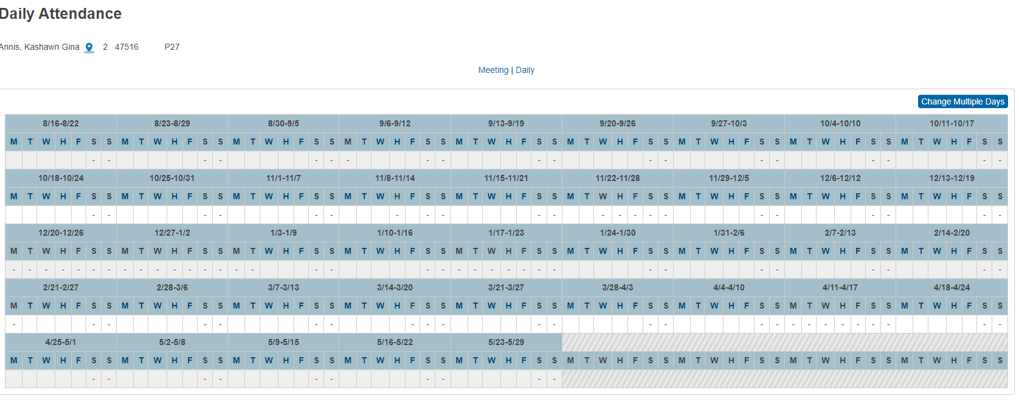
Entering Daily Attendance

Slide 36

Entering Daily Attendance-Selecting a Day
To enter attendance, click on a day (M,T,W,H,F).

Slide 37
Entering Daily Attendance-Attendance Code
Populate the fields below on the "Daily Attendance" page, then submit the page:
    Attendance Code - Select the appropriate attendance code.
    Comment - Enter a comment.
Recommended: Enter attendance codes that would benefit from additional detailed information (such as On-Site Services, etc...)

Slide 38
Entering Daily Attendance-Clock In/Clock Out/Time Comment
  Clock In: Enter the time that the student arrived at school.
  Clock Out: Enter the time that the student left school.
  Exclude from Total Time Calculation: Mark the box to exclude this attendance record from affecting the time attendance calculation for the day (optional).
  Time Comment: Enter a time comment if above is checked (optional).

Slide 39
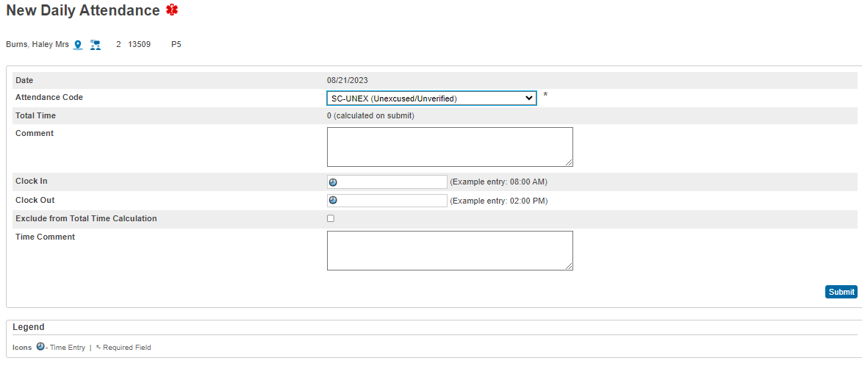
Entering Daily Attendance-Clock In/Clock Out

Slide 40
Daily Attendance Scenarios-Entire Day
Scenario 1: Entering an attendance for a student that has been absent for the entire day.
Find and select the student.
Click on the Attendance page of the selected student.
On the Daily page for the Date, you need to enter an attendance code, click on the character (M,T,W,H,F) of the day.
Select the appropriate Attendance Code from the drop down.
Leave Clock In and Clock Out blank.
Click Submit to save.

Slide 41
Daily Attendance Scenarios Screenshot

Slide 42
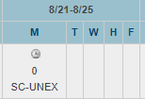
Daily Attendance Scenarios
A zero (0) will display above the Attendance Code when an absence Attendance Code is selected.

Slide 43
Daily Attendance Scenarios Instructions
Select the appropriate Attendance Code from the drop down.
Enter the Clock In for when the student arrived at school.
Then enter the Clock Out for when the student left school.
Click Submit to save.

Slide 44
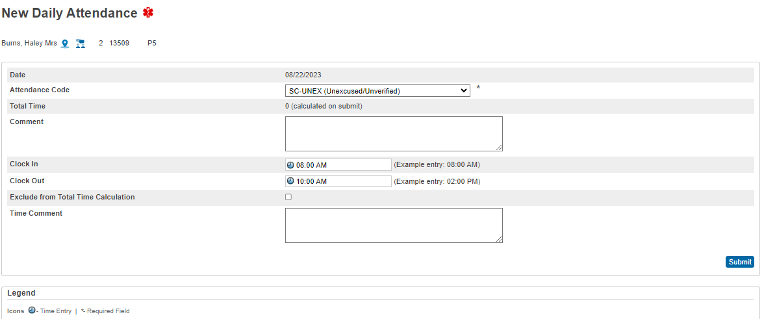
New Daily Attendance Scenarios Screenshot
Notes:
The student arrives at school at 8:00 am and leaves school at 10:00 am. Enter the Clock in and Clock out Time

Slide 45
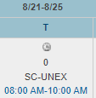
Daily Attendance Scenarios(cont.)
When you enter a Clock In and Clock Out, the Attendance Code will display with zero (0) minutes above the attendance code.
The Clock out that was entered will display below.

Slide 46
Daily Attendance Scenarios Verify Minutes
To verify how many minutes were calculated for that day click on the day.

Slide 47
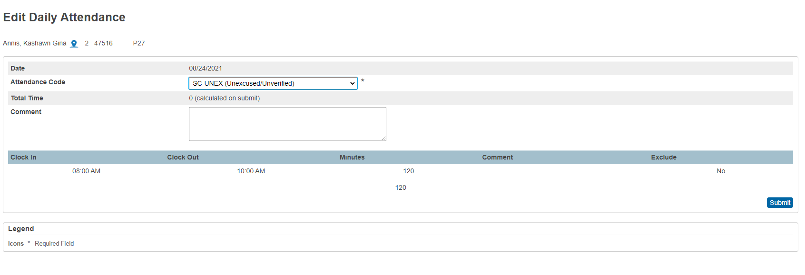
Daily Attendance Scenarios Total Minutes
The “Edit Daily Attendance” will open and the minutes the student was present for that day will appear.
The total minutes the student was present for the day

Slide 48
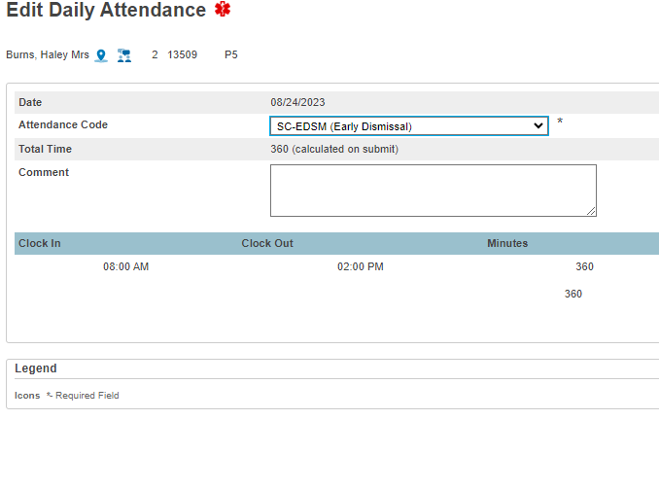

Chronic Absenteeism-Daily Attendance-Early Dismissal
Scenario 2: Entering an attendance code for a student who leaves school early but attend 50 percent of the day.

Slide 49
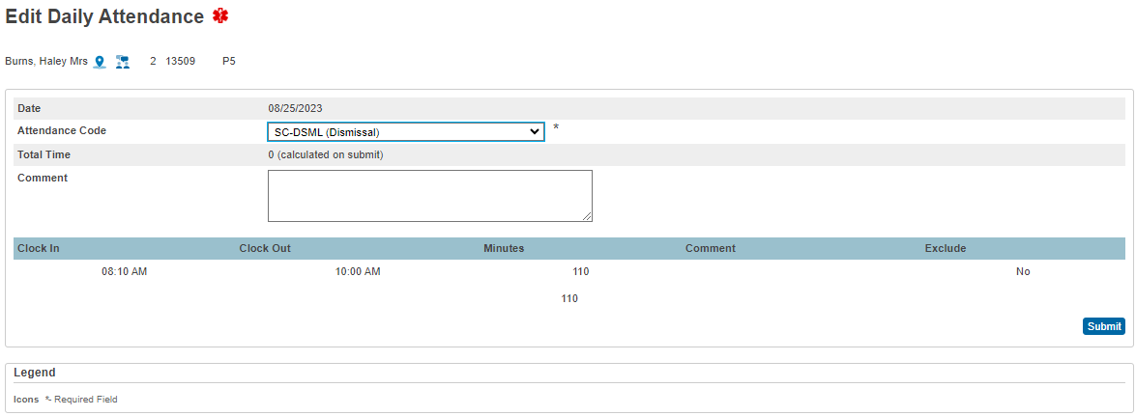

Chronic Absenteeism-Daily Attendance-Dismissal
Scenario 3: Entering an attendance code for a student who leaves school early but did not attend 50 percent of the day.

Slide 50
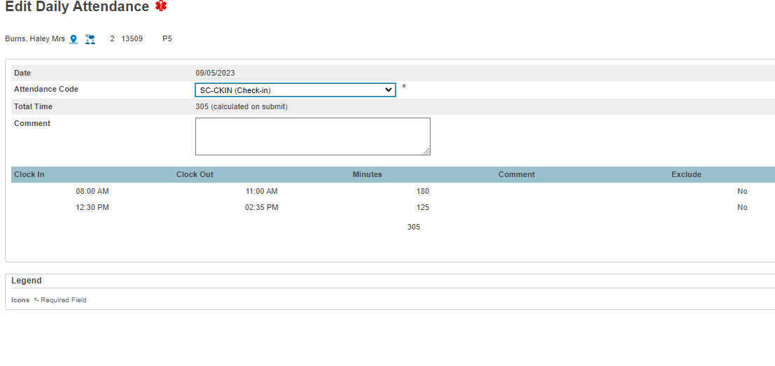

Chronic Absenteeism-Daily Attendance-Check-in
Scenario 4: Entering an attendance code for a student who leaves school for a medical appointment and returns. This student attend 50 percent of the day.
Notes:
The student came to school at 8:00 am and left at 11:00 am for a Dental Appointment. The attendance code was unexcused.
The student returned to school at 12:30 with an excused, the attendance code is updated to SC-CKIN and the Clock in and Clock time is updated.

Slide 51
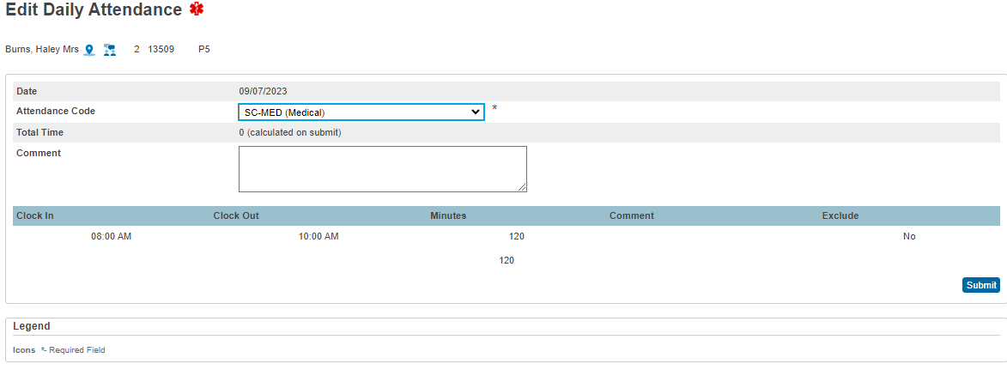

Chronic Absenteeism-Daily Attendance-Medical
Scenario 5: Entering an attendance code for a student who leaves for a medical appointment but did not attend 50 percent of the day.

Slide 52
SC48 Daily Attendance Validation Report
SC 48 Daily Attendance Validation Report flags students who are coded with a present code who did not attend 50 percent of the school day.
The SC 48 Daily Validation Reports flags the following present codes listed below:
    Excused Tardy-SC-ETRD
    Bus Tardy-SC-TRD
    Unexcused Tardy-SC-UTRD
    Check-In-SC-CKIN
    Unexcused Early Dismissal-SC-UEDM
Schools must correct the information display on SC48 Daily Attendance Validation Report by entering an absent code. This report should be corrected before submitting the final chronic absenteeism data.

Slide 53
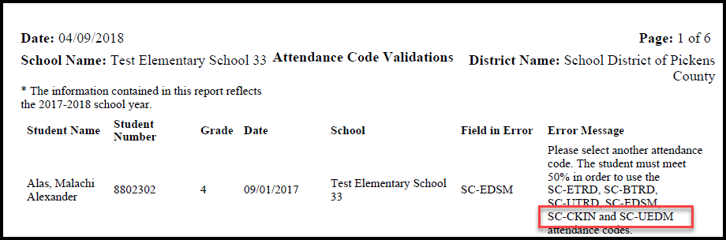
SC48 Daily Attendance Validation Report Changes
SC48 Daily Attendance Validation Report Changes.
Note: This validation report is ONLY for schools that take daily attendance only. (Elementary Schools with 1 period in their Bell Schedule)

Slide 54
Chronic Absenteeism (Meeting Attendance)
Meeting Attendance:
The following scenario is based on a high school bell schedule of 423 minutes.
  A student is present if he/she are in instruction for 212 (211.5 rounded up) minutes, if a student is scheduled for 423 minutes.
  Attendance must be taken each class period.
The Chronic Absenteeism reports looks at the entire minutes in the bell schedule for a school day, then looks at the individual student’s schedule for a school day. See table below:

Slide 55
Chronic Absenteeism (Meeting Attendance Minutes)
CA-Present
CA-Absent
Student | Scheduled minutes | Number of minutes | Present or Absent
Student A | 360 minutes | 179 (Not 50% of the student’s schedule) | Absent
Student B | 400 minutes | 199 (Not 50% of the student’s schedule) | Absent
Student C | 423 minutes | 211 (Not 50% of the student’s schedule) | Absent
Student | Scheduled minutes | Number of minutes | Present or Absent
Student A | 360 minutes | 180 (50% of the student’s schedule) | Present
Student B | 400 minutes | 200 (50% of the student’s schedule) | Present
Student C | 423 minutes | 212 (50% of the student’s schedule) | Present

Slide 56
Entering Meeting Attendance Instructions
Middle Schools and High Schools will have to take attendance every period (meeting).
  Select a student from the Start Page.
  Click Attendance on the student's screen.
  Select Meeting from the top of the page.

Slide 57
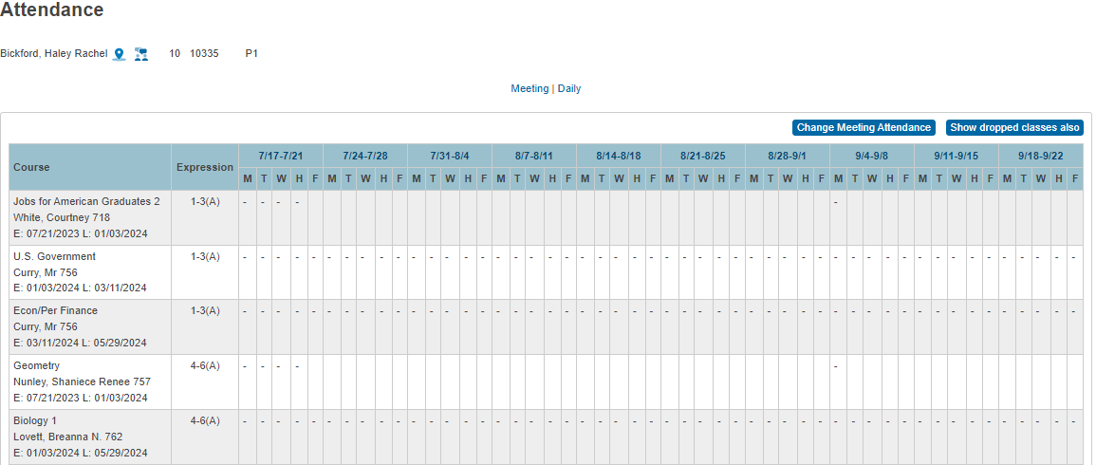
Entering Meeting Attendance

Slide 58
Entering Meeting Attendance Instructions (cont.)
The Meeting attendance screen displays seven weeks across the top of the page and the student's active enrollments along the left-hand side, listed according to expression.
To enter attendance, click on a week.
Click Submit to save changes
Note: If the appropriate week is not listed, change the term at the top of the page to a term with a date range that includes the week.

Slide 59
Entering Meeting Attendance (cont.)

Slide 60
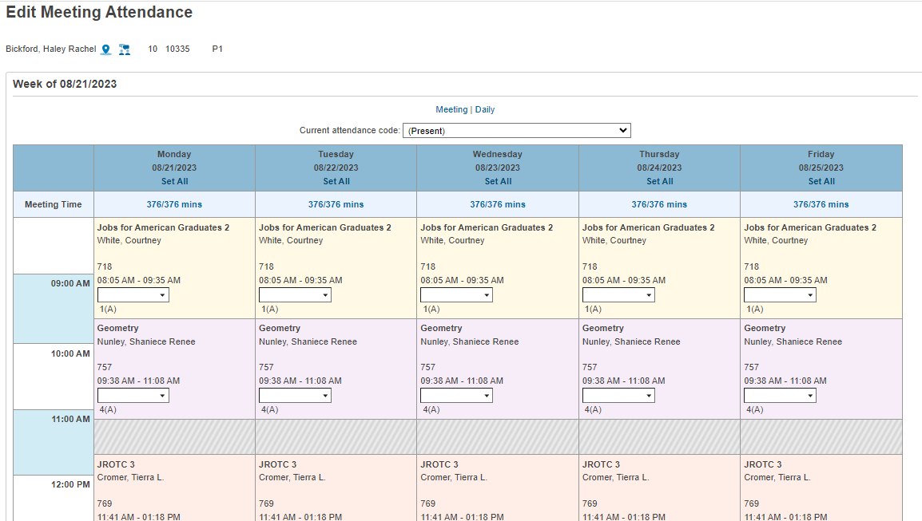
Entering Meeting Attendance Selecting an Attendance Code
Select an attendance code from the "Current attendance code" drop-down.

Slide 61
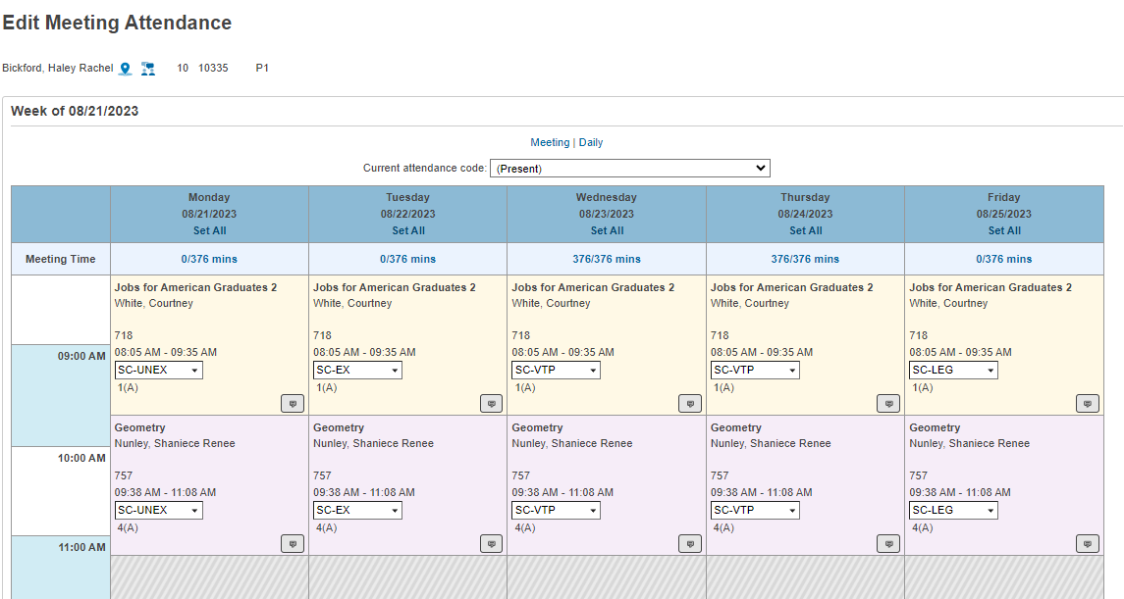
Entering Meeting Attendance (cont.)
After selecting the “Current attendance code,” click in each expression box for each period the student needs an absence attendance code.

Slide 62
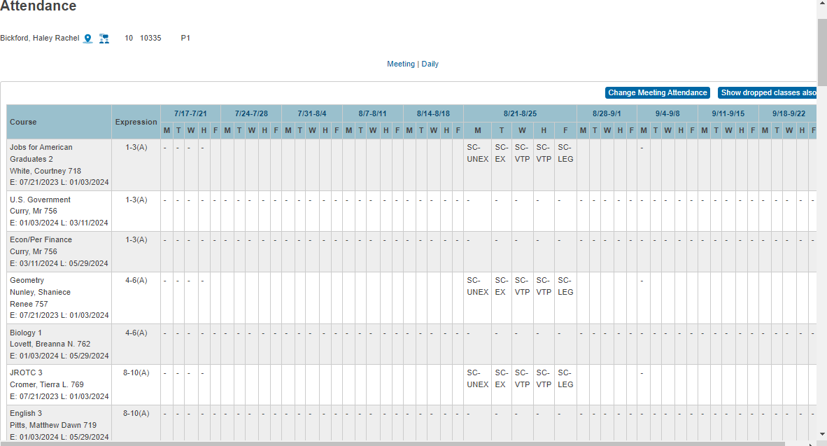
Meeting Attendance

Slide 63
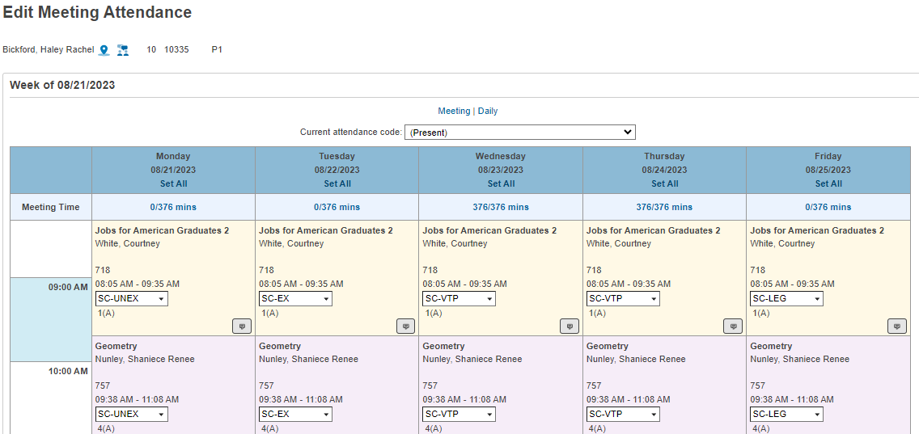
Meeting Attendance Minutes

Slide 64
Customized Chronic Absenteeism, Attendance Reports
On the Start page click System Reports.
Click on the State Reporting tab.
    Chronic Absenteeism
    Attendance

Slide 65
SC 37 Chronic Absenteeism Update Process
The Chronic Absenteeism Update Process will flag students identified as chronically absent. The student must meet the following requirements to be flagged as “Y” for chronically absent:
A student must be enrolled at a school for at least 10 membership days to be included in the calculation.
A student will be flagged as a ‘Y’ (chronically absent) if the attendance recorded in PowerSchool reaches or exceeds the 10 percent days absent of membership days. Absences will include excused, unexcused and/or out of school suspensions.
A student is considered absent if not present 50% or more of the school day.

Slide 66
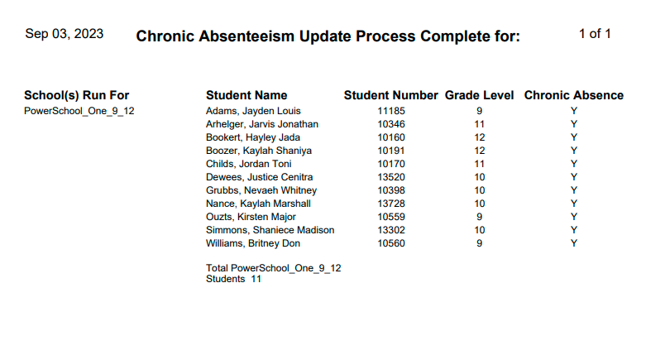
SC 37 Chronic Absenteeism Update Process Results

Slide 67
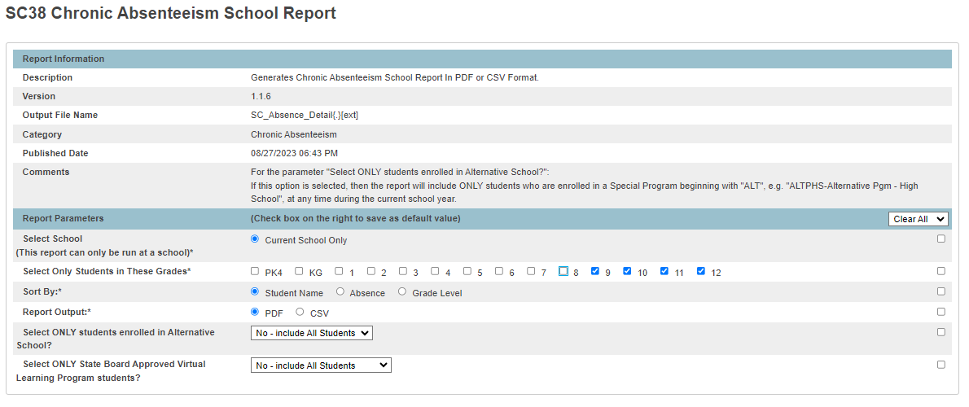
SC38 Chronic Absenteeism School Report-Selecting Grade Levels
Selecting all students

Slide 68
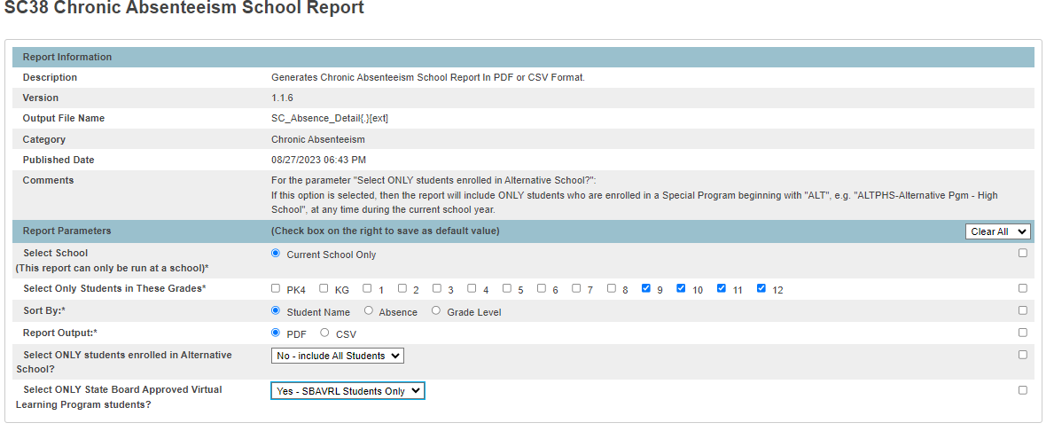
SC38 Chronic Absenteeism School Report-Selecting SBAVRL Students
Selecting SBAVRL Students Only

Slide 69
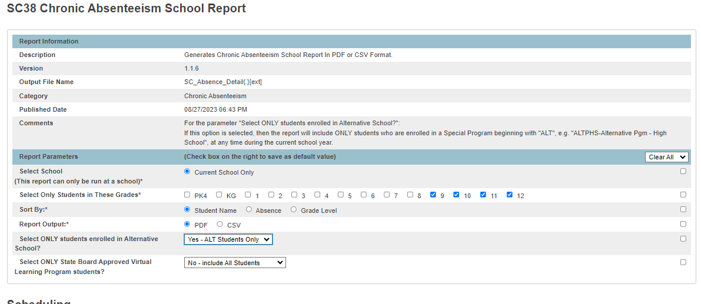
SC38 Chronic Absenteeism School Report-Selecting Alternative School Students
Selecting Alternative Students Only

Slide 70
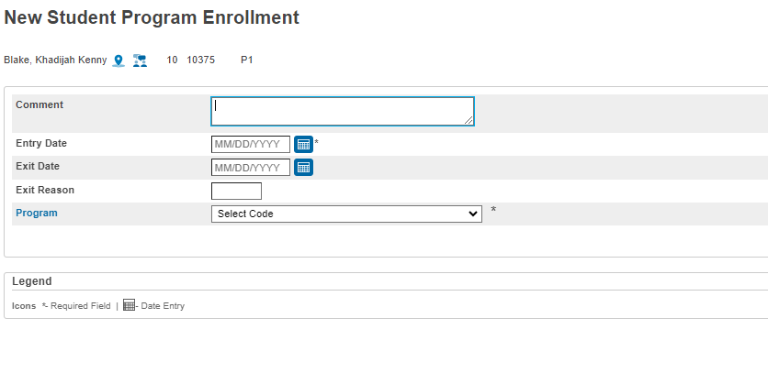

SC38 Chronic Absenteeism School Report-Alternative School Programs
Make sure all Alternative School Program students are coded under the special program field with an entry date

Slide 71
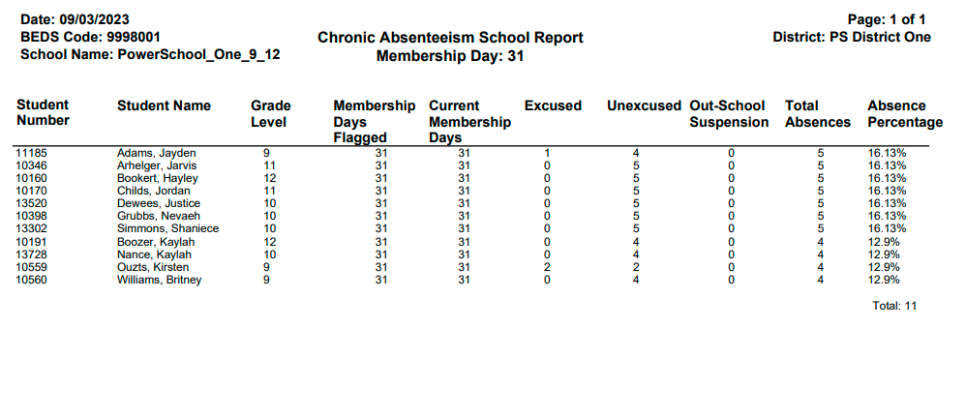
SC38 Chronic Absenteeism School Report
Notes:
Output of the report
Parenthesis around a student’s name identify them as being inactive students.

Slide 72
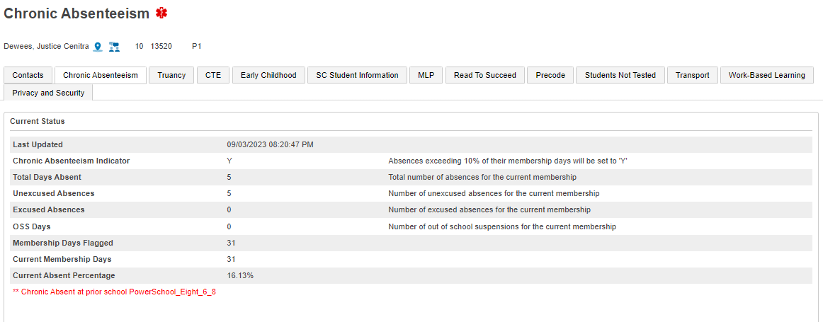
Chronic Absenteeism Page
Calculation- Total Days Absent/Current Membership days X 100= Absent Percentage

Slide 73
Chronic Absenteeism Reminders
Please make sure the following steps are followed before submitting data to SCDE:
  Run the SC 37 Chronic Absenteeism Update Process for all schools in the district.
  Run the SC 38 Chronic Absenteeism School Level Report (pdf version) for all schools in the district.
  Review the school membership days at the top of the SC 38 Chronic Absenteeism School report to ensure the information is updated to the current collection cycle
  Review the report to ensure that the students are reported accurately.
  Review the entry and exit dates for students identified to ensure that this information is correct.
  Review the reports to ensure that “No Show” students are not reported.
  Compare the ADT reports to SC 38 Chronic Absenteeism School Level Report (pdf version) for all schools in the district.

Slide 74
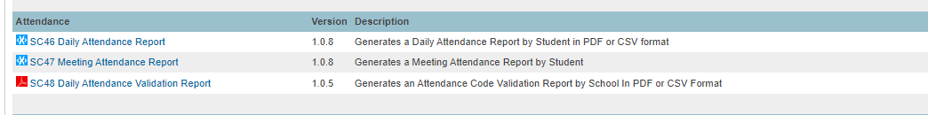
SC 46 Daily Attendance & SC 47 Meeting Attendance

Slide 75
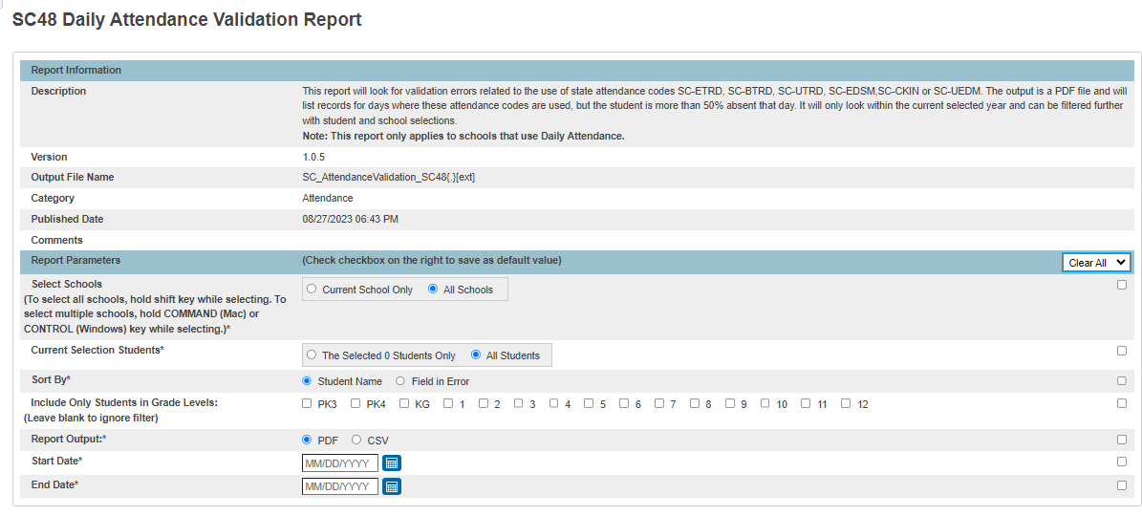
SC 46 Daily Attendance

Slide 76
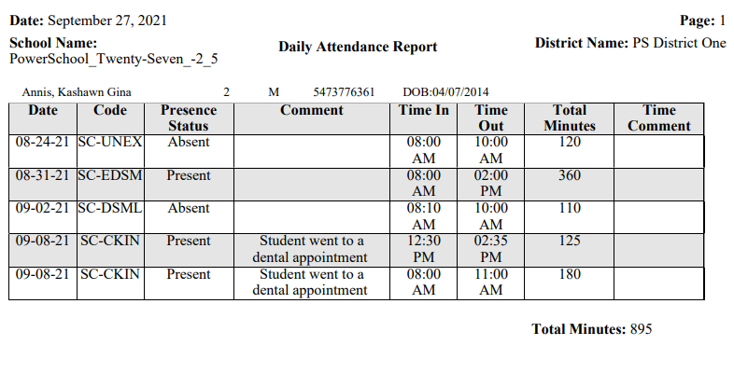
SC46 Daily Attendance PDF Report

Slide 77
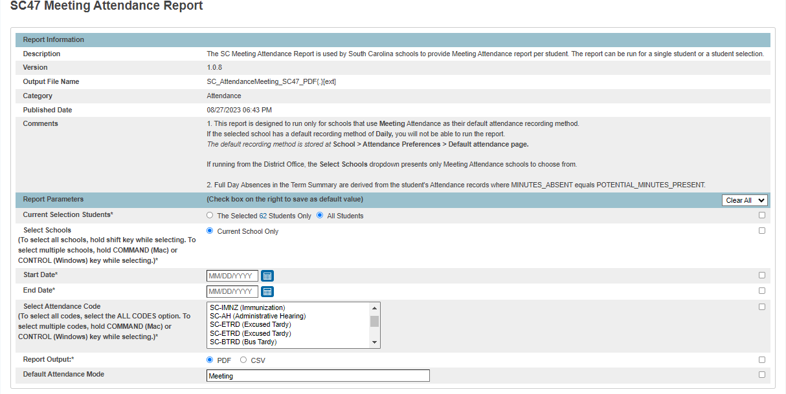
SC 47 Meeting Attendance Report

Slide 78
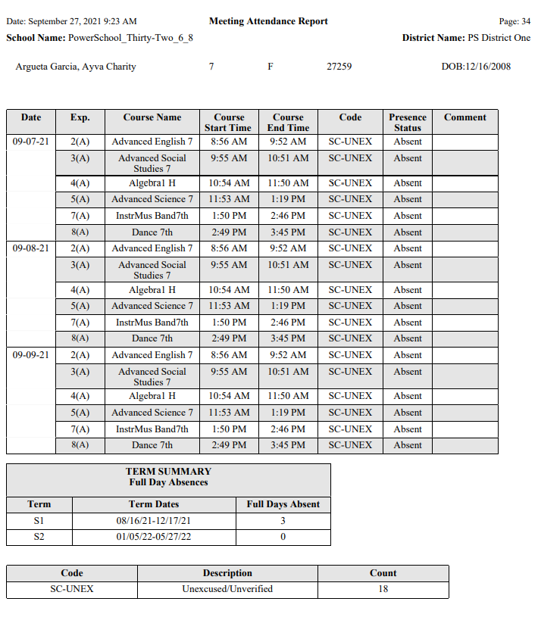
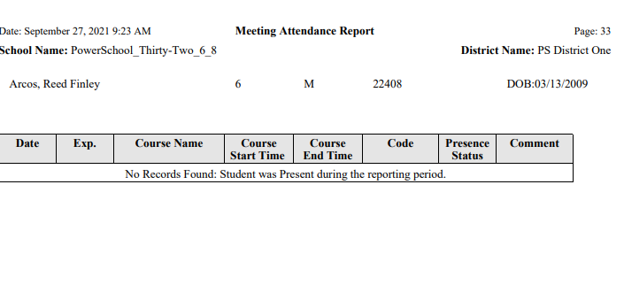
SC 47 Meeting Attendance Report Review

Slide 79

Upcoming Training Opportunities
Click the link below to register for upcoming trainings:
Chronic Absenteeism, Dropout, Truancy, and Incident Management Data Collection
Request Training Materials
Webinar Recording and Training Materials Request 2023-24

Slide 80

Upcoming Training Opportunities
Click the link below to register for upcoming trainings:
Attendance Calendar Planning Webinars:
These sessions will assist school level attendance personnel/teams with creating an engaging attendance calendar for the school year. The calendar is a Tier 1 strategy designed to make school fun and a joyous place to be; for students, families, and staff. During this session you will learn how to promote attendance and integrate attendance interventions.
September 18, 2023-10:00 a.m.-11:00 a.m.-Elementary Schools only
September 18, 2023-11:30 a.m.-12:30 p.m.- Middle and High Schools only

Slide 81
Upcoming Training Opportunities
Click the link below to register for upcoming trainings:
Webinar 6: Improving Student Engagement
September 26, 2023 1:00 pm to 2:30 pm | Webinar 6: Improving Student Engagement - Lessons Learned and Success Stories from Two South Carolina Districts This learning session will feature panel discussions by teams from two South Carolina school districts that have successfully improved student engagement to reduce learning loss and to improve student outcomes. These districts will be identified in consultation with the SC DoE and each separate panel discussion will be moderated by NDPC staff. Each district panel will share lessons learned and success strategies for 25-minute periods followed by 15-minute periods for participant questions and feedback. | September 2023

Slide 82

Upcoming Training Opportunities
Blended Diploma Planning Institutes - Memo PDF (145 KB)
Registration Link (Team registration)

Slide 83


Attendance Resources
September is Attendance Awareness
www.attendanceworks.org

Slide 84
Links to Resources/Sources
Using Chronic Absence Data to Improve Conditions for Learning
Examples of Tiered Practices - Attendance Works
Blank Tiered Form
Indicators and Interventions Research a Practical Manual for Early Warning Systems
Attendance Works
Everyone Graduates
The Use of Student Attendance to Build Districtwide Trauma-Informed Care – National Dropout Prevention Center

Slide 85

Attendance Resources
Attendance Playbook

Slide 86
Attendance Resources
Resources from the Attendance Works Sessions:
Caring Conversations worksheet
Year Round MTSS Planning Calendar
Worksheet to list school community & external partners
Download the example PDSA worksheet
Download the blank PDSA worksheet
Strategies for Connecting with Students & Families
Guide to Using the Attendance Playbook: Smart Solutions for Reducing Student Absenteeism Post-Pandemic - Attendance Works

Slide 87
Resources
Improving Attendance and Reducing Chronic Absenteeism
Showing Up Matters for R.E.A.L. - Attendance Works
Attendance Playbook
Implementation Guide
Truancy Intervention Guide: Training and Resource Manual for Responding to Truancy in South Carolina - School of Law | University of South Carolina
Tool Kit for Creating Your Own Truancy Reduction Program (ojp.gov)

Slide 88

Questions

Slide 89
Discipline and Attendance Question E-mail Box
Please submit your questions to this email box:
  discipline@ed.sc.gov
  attendance@ed.sc.gov

Slide 90


Contact Information
Aveene R. Coleman
Phone: 803-734-3057
Fax: 803-734-5281
acoleman@ed.sc.gov

