Slide 1
Improving Children’s Health By Attending to Attendance
SAMPLE PHOTO

Slide 2
Council on School Health
Mission The Council on School Health (COSH) is dedicated to maximizing the personal health, academic achievement and life-long success of children and adolescents. The COSH seeks to promote sound school health policies and practices that ensure the health and safety of school-aged children and adolescents through policy, education and advocacy.
Interested in Joining the Council?
Visit https://services.aap.org/en/community/aap-councils/council-on-school-health/
- OR-
Contact SchoolHealth@aap.org

Slide 3
Learning Objectives
By participating in the webinar, attendees will be able to:
Define chronic absenteeism and describe its scope and impact on child health and academic success.
Describe health-related (both physical and emotional) causes of chronic absenteeism and identify evidence-based interventions to address these causes.
Identify steps that child health providers can take to address chronic absenteeism in their practice or community.

Slide 4
Framing the Discussion: Chronic Absence and the Pediatrician
Notes:
Before we jump into the meat of the conversation, let’s spend a moment grounding the conversation. Today’s discussion is about helping child health providers better understand the connection between health and absenteeism, and digging into the “why” and “how” clinicians can engage on this important issue.
When asked about their work to address school attendance, pediatricians often acknowledge that school attendance is important – but be unclear about why and how the topic should be prioritized among ALL of the other things to be addressed in clinical practice. If you’re thinking about that question right now, consider the challenge to reflect on school attendance as the sixth vital sign. We know that school absences often result from health and social challenges for our patients and their families, and that in asking about school absences, we may unearth concerns that we are well suited to address but wouldn’t otherwise have heard about. We also know that excessive absences from school are strongly correlated with academic failure, which is associated in turn with long-term health impacts. In that light, addressing school absences and academic performance may be one of the leading opportunities we have to support our patient’s long-term health and wellbeing.
With that, let’s move on to a case study.

Slide 5
Case Study

Slide 7
Case Study
Asking about school attendance led to understanding key issues for Jane and her mother
Bullying
Transportation
Housing
Engaging health care team members made a difference
Family navigator
School nurse
Notes:
Engaging health care team members:
In this case, the clinic had family navigators who were able to reach out to Jane’s mom and give her information about low-income housing options and discuss how to address her transportation issues for getting Jane to school.
The clinic’s medical assistant had Jane’s mother sign a release of information between our clinic and Jane’s school and faxed it to the school.
The pediatrician reached out the school nurse to touch base about her concerns for bullying and anxiety; Jane’s school had regular meetings to talk about students who needed extra support; the school nurse got Jane added to a regular meeting agenda and the school counselor was able to provide Jane with some support for her anxiety at school.

Slide 8
Discussion Question
How frequently do you ask about school attendance as part of routine office visits?
Always/almost always
Frequently
Sometimes
Rarely/never

Slide 9
Chronic Absenteeism: What is it? Why does it matter?
For more resources, visit www.attendanceworks.org and www.healthychildren.org

Slide 10
What is Chronic Absence?
Chronic absence is missing so much school for any reason that a student is academically at risk. California defines it as missing 10% or more of school for any reason.
Chronic
Absence
Excused absences
Unexcused absences
Suspensions
Chronic absence is different from truancy (unexcused absences only) or average daily attendance (how many students show up to school each day).

Slide 11
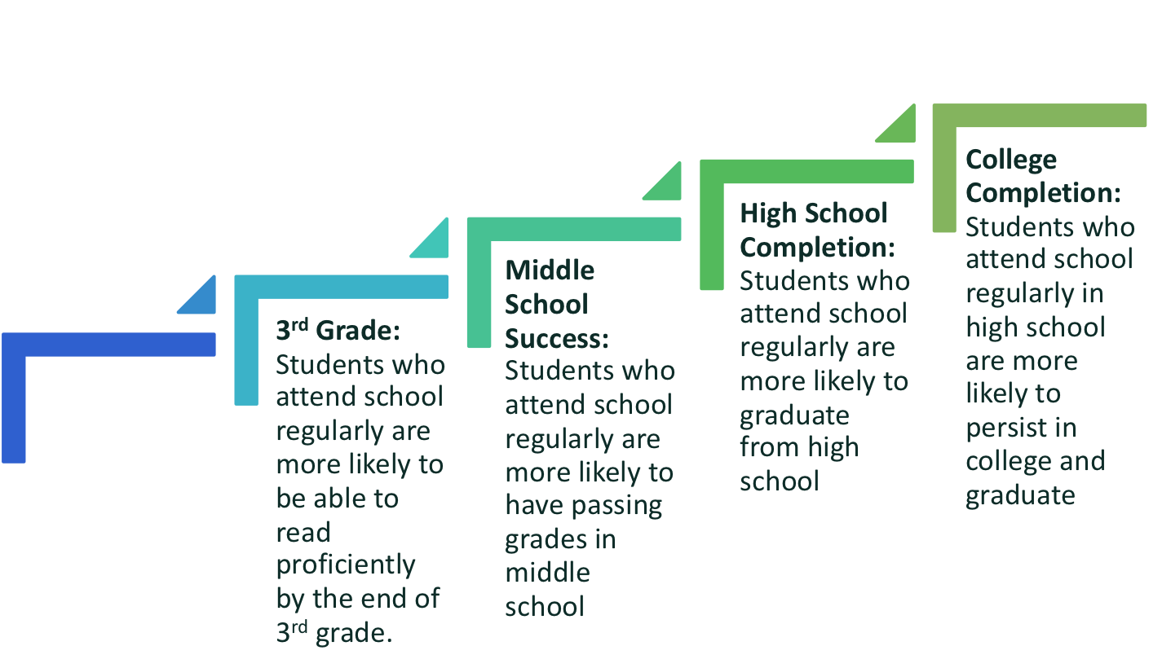
Student Attendance is Strongly Associated with Academic Success
Chronic Absence = Warning Sign of Academic Risk
PK-1st Grade: Students who attend regularly in the early grades perform better on measures of academic and social and emotional capacities.

Slide 12
Reducing Chronic Absence Can Help Close Equity Gaps
Vulnerable children, especially those living in poverty, are 2-3 times more likely to experience chronic absence at earlier ages.
Vulnerable children are much less likely to have the resources to make up for lost learning time in the classroom.
Vulnerable children are more likely to experience multiple years of chronic absence

Slide 13
Barriers
Illness, both chronic and acute – physical and mental
Negative School Experiences
Struggling academically and behaviorally
Lack of Engagement
Lack of or inequitable access to challenging, culturally responsive, engaging instruction & enrichment
Misconceptions
Absences are only a problem if they are unexcused
Bullying
Suspensions and expulsions
Negative attitudes of parents due to their own school experience
Undiagnosed disability
Lack of appropriate accommodations for disability
Trauma
Unsafe path to/from school
Poor transportation
Frequent school changes
Involvement with child welfare or juvenile justice systems
No meaningful or negative relationships to adults in the school
Stronger ties with peers out of school than in school
Unwelcoming school climate
Lack of health, mental health, vision, or dental care
Failure to earn credits/ no future plans
Many teacher absences or long-term substitutes
Family responsibilities
Bored
Social challenges
Lack of or ineffective academic, emotional and behavioral support
Housing and food insecurity
Ineffective or harmful interventions
Harsh, biased disciplinary practices especially for students of color
Inequitable access to resources due to bias & discrimination.
Pressure for academic success
Depression or anxiety
Missing 2 days per month doesn’t affect learning
Sporadic absences aren’t a problem
Attendance only matters in the older grades
Suspensions are not relevant

Slide 14
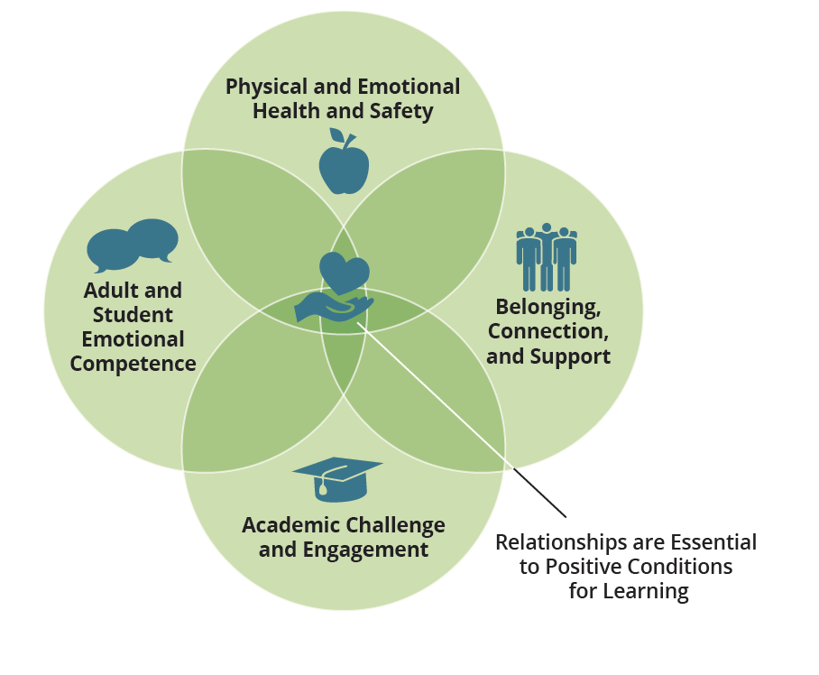
High Levels of Chronic Absence = Poor Conditions for Learning

Slide 15
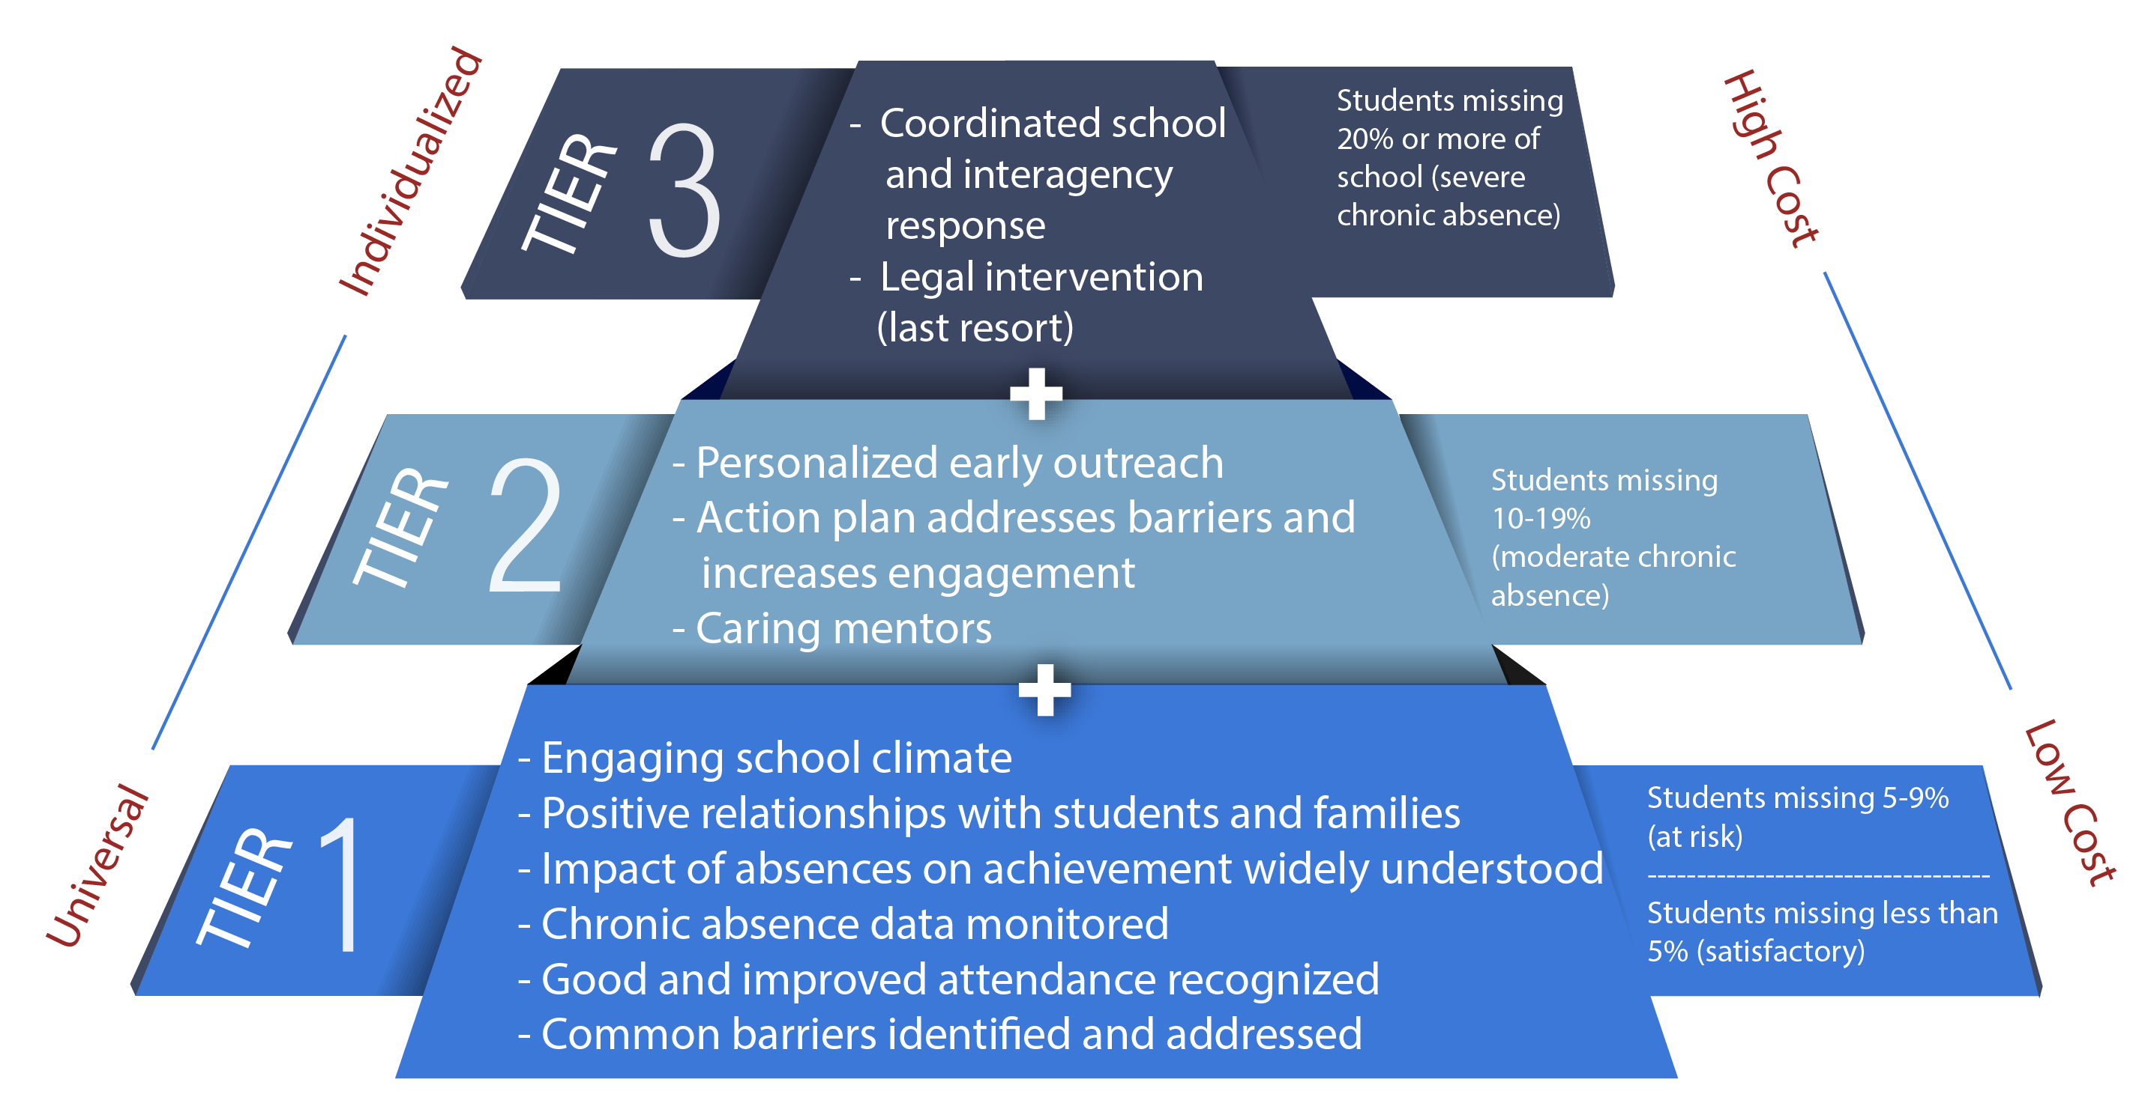
Invest in Prevention and Early Intervention

Slide 16
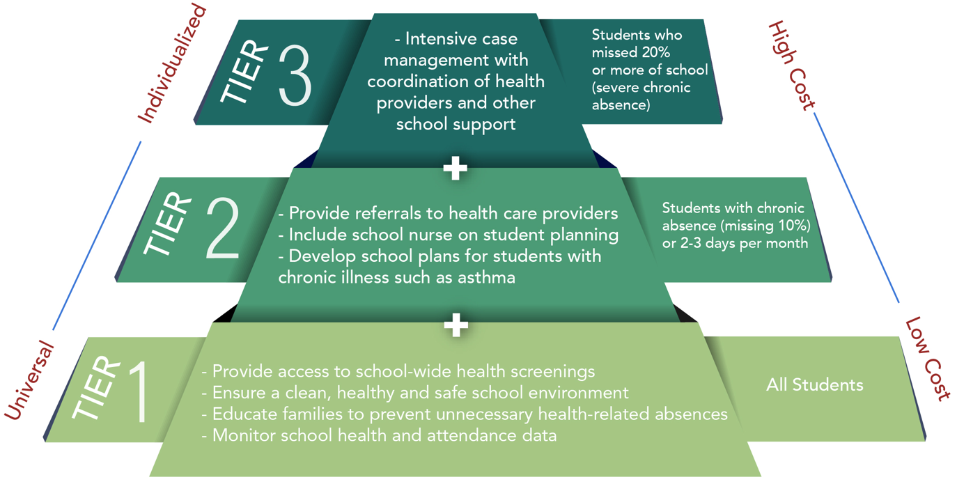
Health Framework for Chronic Absence

Slide 17
Chronic Absence is a Cross-Cutting Metric
Chronic absence is a warning sign that a health-related condition may need to be addressed.
Chronic absence is a predictor of worse education and health outcomes
Chronic absence: The Newest Social Determinant of Health?
Notes:
Now that 36 states plus DC have elected to include chronic absence as a school quality metric in their accountability plans under the Every Student Succeeds Act, there is new attention being paid to it across the country.

Slide 18
What is the policy opportunity (and challenge)?
Positive Engagement:
Uses caring relationships, effective messaging and a positive school climate to motivate daily attendance.
Actionable Data:
Is accurate, accessible, and regularly reported in an understandable format.
Community
District
Positive Engagement
Actionable Data
Schools
Students & Families
Shared Accountability
Capacity Building
Capacity Building Expands ability to work together to interpret data, engage in problem solving, and adopt best practices to improve attendance.
Shared Accountability:
Ensures chronic absence is monitored & reinforced by policy.
Strategic partnerships
between district and community partners address specific attendance barriers and mobilize support for all ingredients.

Slide 19
Chronic Absence Data Now More Available Than Ever
Available nationally through the Office of Civil Rights and soon Ed Facts
Now published annually by the majority of states
Must be reported under Every Student Succeeds Act (ESSA) in all states; 2/3rds of states adopted it as an accountability metric
Increasingly produced in real-time by school districts

Slide 20
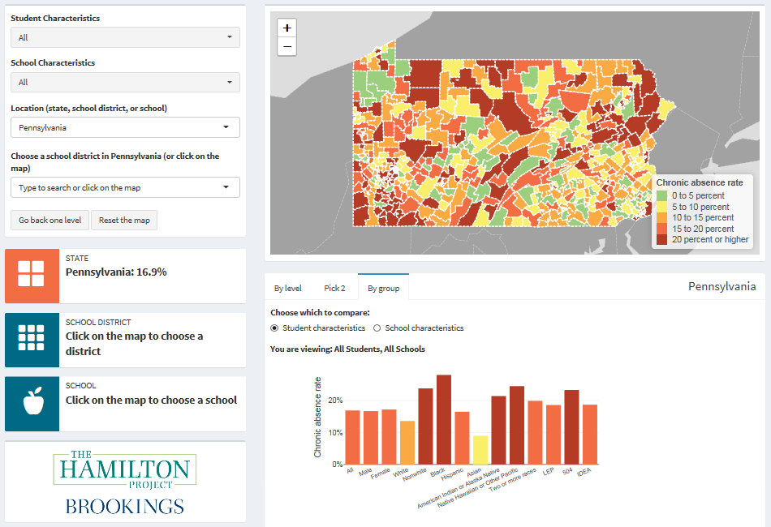
https://www.hamiltonproject.org/charts/chronic_absence_across_the_united_states
20
Notes:
For those of you who want to dig more deeply into differential rates of chronic absence at the school, district, and state level, you might be interested in The Hamilton Project’s interactive Chronic Absence across the United States. In the example, we see how the rates of chronic absence differ by student characteristic for the whole state of Pennsylvania.

Slide 21
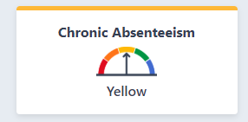
Annual Data Increasingly Available from State Departments of Education
For example: In California, chronic absence is now a K-8 metric. It can be found on the state dashboards and interactive data system called DataQuest https://dq.cde.ca.gov/dataquest
https://www.caschooldashboard.org/

Slide 22
American Academy of Pediatrics
Policy statement on chronic absence released January 28, 2019
The Link Between Good Attendance and Health http://pediatrics.aappublications.org/content/early/2019/01/24/peds.2018-3648
The statement includes:
Summary of studies on health-related causes of absences
Summary of evidence for physical and mental health interventions
Recommendations to pediatricians on addressing school attendance

Slide 23
Evidence-Based Interventions to Address Health-Related Causes of Chronic Absenteeism

Slide 24
Infection Prevention
Effect of Hand Hygiene Instruction
Effect of Influenza Vaccination
From: King, JC, NEJM December 2006
From: Lau CH, BMC Pediatr May 2012

Slide 25
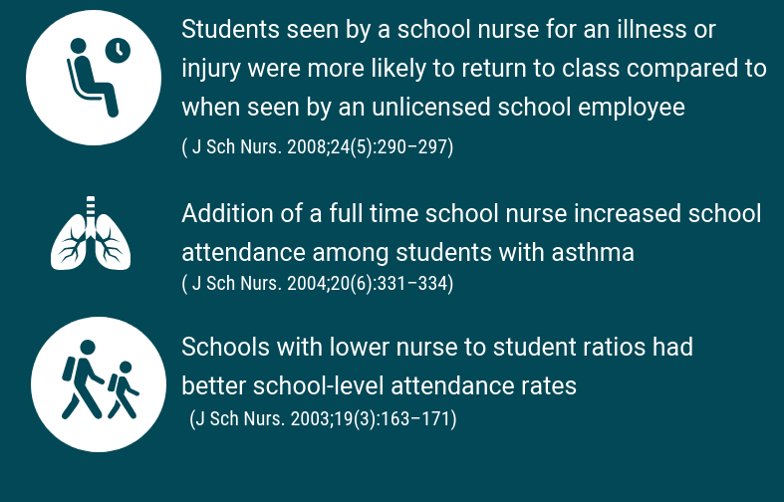
School Nurses

Slide 26
School-Based Health Centers

Slide 27
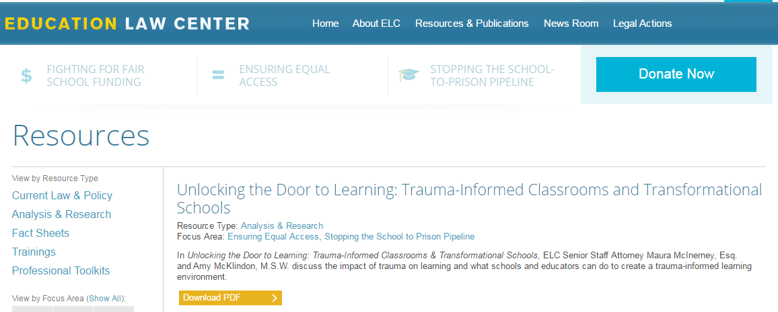
Mental Health Care
Some interventions that have specifically been shown to reduce absenteeism include:
Cognitive behavioral therapy
Trauma-informed schools

Slide 28
School Policies and Parent Interventions
Policies that promote a positive school climate
Policies that promote school connectedness
Communication and workshops with parents regarding school attendance
Strong monitoring of attendance by parents

Slide 29
Coordinated School Health
Whole School, Whole Community, Whole Child Model
Notes:
The components of this model are: health education; physical education and physical activity; nutrition environment and services; health services; counseling, psychological, and social services; social and emotional climate; physical environment; employee wellness; family engagement; and community involvement.
While not all of these components have been studied in relation to school attendance, a recent, comprehensive summary of the literature indicates that each component plays a role in improving children’s academic performance. Aspects of nutrition services (breakfast at school); health services (nursing services); counseling, psychological, and social services (school-based mental health care); social and emotional school climate (school connectedness); physical environment (full spectrum lighting, reduction of physical threats, indoor air quality); family engagement; and community involvement have all been associated with improved school attendance.

Slide 30
Steps that Child Health Providers Can Take to Address Chronic Absenteeism

Slide 31
Discussion Prompts
As you review each tier, we encourage you to pause for discussion of strategies from that tier that you have implemented in your clinical practice or community.

Slide 32
Tier 1—Approaches for ALL Youth
Individual level:
At every visit, ask about number of missed school days in past month
Praise patients/caregivers for good school attendance
Talk about the impact of school absences on school performance and future wellness
Talk about how absences can add up
Promote school attendance with posters, videos, handouts
Educate yourself and staff about appropriate and inappropriate reasons to exclude children from school

Slide 33
Tier 1—Approaches for ALL Youth
Systems level:
Advocate for policies and interventions known to promote school attendance
Collaborate with community leaders to promote school attendance
Support school districts’ efforts to improve access to health insurance and medical services
Encourage and support data sharing to better understand patterns and causes of chronic absenteeism in your community

Slide 34
Tier 2—Missing 2-3 Days per Month
Prevent, identify, and treat physical and mental health conditions that are contributing to school absences
Help patients/caregivers address family factors that are barriers to attending school
Collaborate with school professionals and community partners to manage the health and social challenges of your patients and families experiencing chronic absenteeism
Encourage caregivers of students with excessive absences to seek a formal school team meeting

Slide 35
Tier 3—Missing > 4 Days per Month
Encourage the school or school district to provide services such as intensive case management and mentorship
Collaborate with professionals providing support services in school
Consider if an alternative to current school situation is appropriate
Serve as your patient’s advocate and medical expert

Slide 36
Questions & Discussion
What questions does this discussion raise for you?
What strategies most resonate for you to implement in your practice or community?
What other partners might you need to engage to be successful in this work?

Slide 37
Thank you & Next Steps
We encourage you to be ambassadors of the opportunity to support school attendance in your clinical practice and community!
Examples:
Consider hosting a brown bag with your practice or health system colleagues, using the recent AAP webinar recording or this PPT deck.
Consider engaging your local or state AAP chapter.
Consider reaching out to your local school district or state education agency to discuss opportunities for partnership.

Slide 38
Thank you & Next Steps
Want to continue the conversation? Additional questions?
Contact SchoolHealth@aap.org.
Consider joining AAP Council on School Health! https://services.aap.org/en/community/aap-councils/council-on-school-health/
Resources:
AAP Policy Statement “The Link Between Good Attendance and Health”: http://pediatrics.aappublications.org/content/early/2019/01/24/peds.2018-3648
http://attendanceworks.org/
https://healthyschoolscampaign.org/chronic-absenteeism/

