Slide 1


Reducing Chronic Absence
Requires a Trauma Informed Approach
July 26, 2018 Grade-Level Reading Week, Philadelphia www.attendanceworks.org

Slide 2

What is Chronic Absence?
Chronic absence is missing so much school for any reason that a student is academically at risk. Attendance Works recommends defining it as missing 10% or more of school for any reason.
Chronic
Absence
Excused
absences
Unexcused absences
Suspensions
Chronic absence is different from truancy (unexcused absences only) or average daily attendance (how many students show up to school each day).

Slide 3
Chronic Early Absence Connected to Poor Long- Term Academic Outcomes
Chronic absence in kindergarten
Lower levels of
literacy in first grade
Lower achievement as far out as fifth grade
A Rhode Island Data Hub analysis found that compared to kindergartners who attend regularly, those chronically absent:
Scored 20% lower in reading and math in later grades and gap grows.
2X as likely to be retained in grade.
2X likely to be suspended by the end of 7th grade.
Likely to continue being chronically absent.
Notes:
Chronic early absence is the percentage of children in grades K-3 that miss 10% or more of the school year (or 18+ days in a 180-day school year).
Research shows that children who are chronically absent in kindergarten
Show lower levels of literacy in 1st grade
AND that chronic absence in kindergarten can predict lower achievement as far out as the 5th grade.
It is easy to overlook the prevalence of chronic early absence and think you don’t have an attendance problem if you only look at average daily attendance.
BUT in 2012, Rhode Island’s 4 core cities had an average daily attendance rate of 94%, BUT almost 1 in 5 students (19%) were chronically absent.
Chronic early absence can be reduced by using data to regularly identify and intervene with students who have multiple absences, engaging, educating and providing supports for families, personalizing the educational experience for all students, and educating communities to support school attendance.

Slide 4

Reducing Chronic Absence Can Help Close Equity Gaps
Vulnerable children, especially those living in poverty, are 2-3 times more likely to experience chronic absence at earlier ages.
Vulnerable children are much less likely to have the resources to make up for lost learning time in the classroom.
Vulnerable children are more likely to experience multiple years of chronic absence

Slide 5
Emerging Research Suggests…
Chronic Absence can help educators anticipate what is needed to offer effective, engaging, trauma-informed instruction.
Chronic absence is a warning sign that a student, for example,
lacks preschool experience
has been exposed to trauma (higher ACEs)
is struggling with challenges at home or in the community
isn’t finding the classroom experience relevant, etc.

Slide 6
Factors That Contribute to Chronic Absence
Barriers
Illness, both chronic and acute
Negative School Experiences
Struggling academically or socially
Lack of Engagement
Lack of culturally relevant, engaging instruction
Misconceptions
Absences are only a problem if they are unexcused
Bullying
Suspensions and expulsions
Negative attitudes of parents due to their own school experience
Undiagnosed disability
Missing 2 days per month doesn’t affect learning
Sporadic absences aren’t a problem
Attendance only matters in the older grades
Lack of appropriate accommodations for disability
Trauma
Unsafe path to/from school
Poor Transportation
Frequent moves or school changes
Involvement with child welfare or juvenile justice systems
No meaningful relationships with adults in school
Stronger ties with peers out of school than in school
Unwelcoming school climate
Lack of health, mental health, vision, or dental care
Failure to earn credits / no future plans
Many teacher absences or long-term substitutes

Slide 7
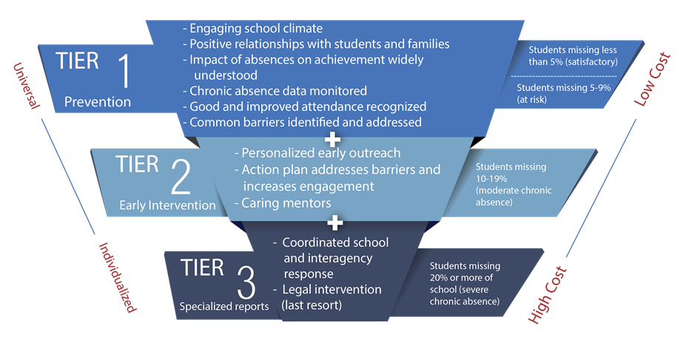
Requires Investing in Prevention and Early Intervention
Notes:
Engagement + Attendance is also part of the webinar Series: Reducing Chronic Absence: It’s a Matter of 1, 2, 3!

Slide 8
Key Ingredients of Change
Positive Engagement:
Uses caring relationships, effective messaging and a positive school climate to motivate daily attendance.
Actionable Data:
Is accurate, accessible, and regularly reported in an understandable format.
Community
District
Positive Engagement
Actionable Data
Schools
Students & Families
Shared Accountability
Capacity Building
Capacity Building
Expands ability to work together to interpret data, engage in problem solving, and adopt best practices to improve attendance.
Shared Accountability:
Ensures chronic absence is monitored & reinforced by policy.
Strategic partnerships
between district and community partners address specific attendance barriers and mobilize support for all ingredients.
Notes:
At same time, we know schools and communities can understand why kids aren’t in school and turn attendance around when they implement these five strategies with fidelity. How schools carry them out can be tailored to their own realities and strengths.
Then – I go through and offer examples of what each one of these might look like. I also clarify that recognizing good and improved attendance isn’t just providing perfect attendance awards for a semester or year– which doesn’t help to motivate improvement among the students with the most problematic attendance.

Slide 9
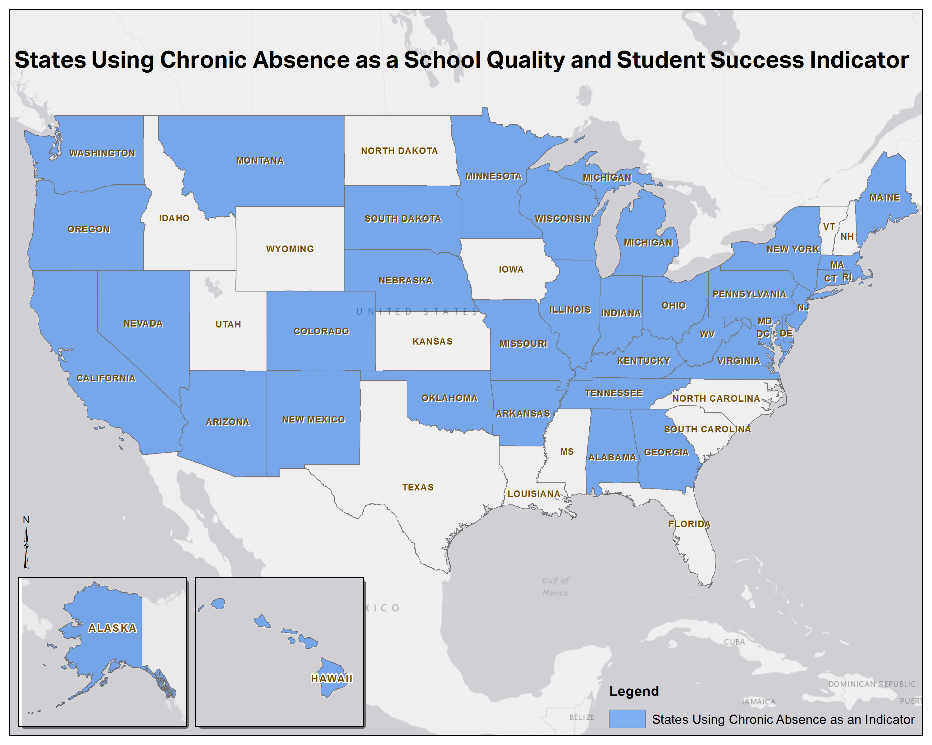
36 states + DC adopted chronic absence as a metric in their ESSA plans.
The vast majority adopted the definition recommended by Attendance Works.
Who's In: Chronic Absenteeism Under the Every Student Succeeds Act
FutureEd, Georgetown University, September 2017.

Slide 10
ESSA Implementation Offers Unprecedented Opportunities and Challenges
Spring 2018
States establish business rules to ensure attendance data is accurate, consistent and reliable
Summer 2018 – Fall 2018
States establish rating systems and targets for school accountability.
Winter 2019
Spring 2019
The bottom 5% of low performing schools will be identified and will be required to conduct a needs assessment
Schools build chronic absence into school improvement plans
States develop their school report cards
LEAs create ESSA plans

Slide 11
Effective Implementation Requires New Paradigm on Attendance
Truancy
Counts unexcused absences
Emphasizes individual compliance with school rules
Uses legal, typically more punitive, solutions
Chronic Absence
Counts all absences
Emphasizes academic impact of missed days
Uses preventive problem-solving, trauma-informed strategies

Slide 12

Cleveland Story
https://youtu.be/ELacS6N7ZGc

Slide 13
Panelists
Lorri Hobson
Director of Attendance
Cleveland Metropolitan School District
David Osher
Vice President
American Institute for Research

Slide 14

Sharing the Cleveland Story
(David Osher & Lorri Hobson)
To what extent is trauma a factor contributing to chronic absence in Cleveland?
What has worked to embed a trauma informed approach into Cleveland’s efforts to reduce chronic absence?
Given Cleveland’s experience what do you think communities should stop or start to do to promote a trauma informed approach to reducing chronic absence?
Questions from the Audience

Slide 15
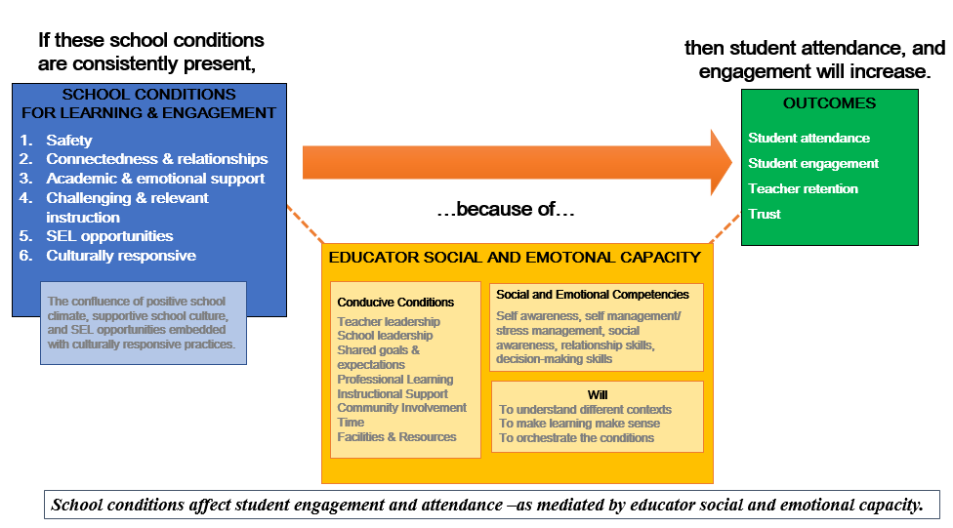
Connection Between Chronic Absence and SEL Capacity
Source: David Osher, American Institutes for Research

Slide 16
Reflections
Turn to a partner and discuss:
What are the implications of Cleveland’s experience for your community?
What could you do to adopt or promote a trauma informed approach to reducing chronic absence?

