Slide 1


Introducing Our Newest Toolkit Early and Often
Showing Up In Preschool Matters
Overview March 2016 www.attendanceworks.org

Slide 2
About this Powerpoint
This power point is designed to help you share what is in the Early and Often Toolkit and engage in a discussion about how to apply the ideas to your own high quality early childhood programs.

Slide 3
What is covered in this PowerPoint
I. What Is The Purpose Of Early and Often?
II. What Is Chronic Absence?
Why Does Attendance Matter?
Who Can Make a Difference?
What Can We Do?

Slide 4
I. What is the purpose of the Early and Often toolkit?
Toolkit Purpose: To equip high quality preschools to engage and support families so that children attend preschool every day possible.
Go to the on-line version http://www.attendanceworks.org/tools/for-early-care-providers/early-education-toolkit/ to see more.

Slide 5

II. What is Chronic Absence?
Chronic absence is missing so much school or preschool for any reason that a student is academically at risk. Attendance Works recommends defining it as missing 10% or more of school/preschool for any reason.
Chronic
Absence
Excused
absences
Unexcused
absences
Suspensions
Chronic absence is different from truancy (unexcused absences only) or average daily attendance (how many students show up to school each day).

Slide 6
Chronic Absence Can Be Very High Even When ADA = 85%
Chronic absence vs ADA across 7 preschool classrooms in one early childhood center with 84.46% ADA
Source: Average Enrolled Attendance for month of February 2013

Slide 7

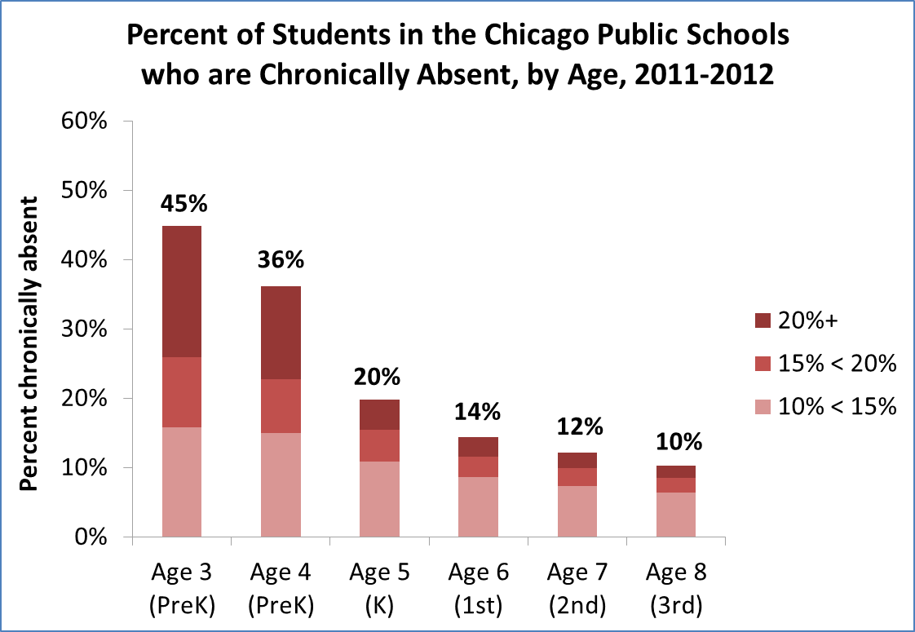

Chronic Absenteeism Can Start Very Early
New York City- July 2008
Strengthening Schools by Strengthening Families, New School, Oct 2008
Notes:
Who is most likely to exhibit chronic absenteeism?

Slide 8
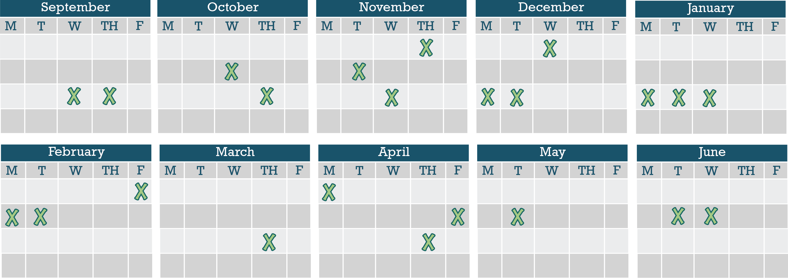
Chronic Absence Is Easily Masked If We Only Monitor Missing Consecutive days
Chronic Absence = 18 days of absence = As Few As 2 days a month
Notes:
It’s easy not to notice when your child may be missing too much school. 10% of a school year is about 18 days of absence. That sounds like a lot but when you break it down, that’s just two days a month. Most parents don’t get too stressed out if their child misses two days of class in a month. But when it happens month after month, it becomes a problem. Why?

Slide 9

III. Why Does Attendance Matter?
Attainment Over Time
Achievement Every Year
Attendance Every Day
Advocacy For All
4 A School Success Framework
  Developed by Annie E. Casey Foundation & America’s Promise Alliance
  For more info go to http://www.americaspromise.org/parent-engagement-toolkit

Slide 10

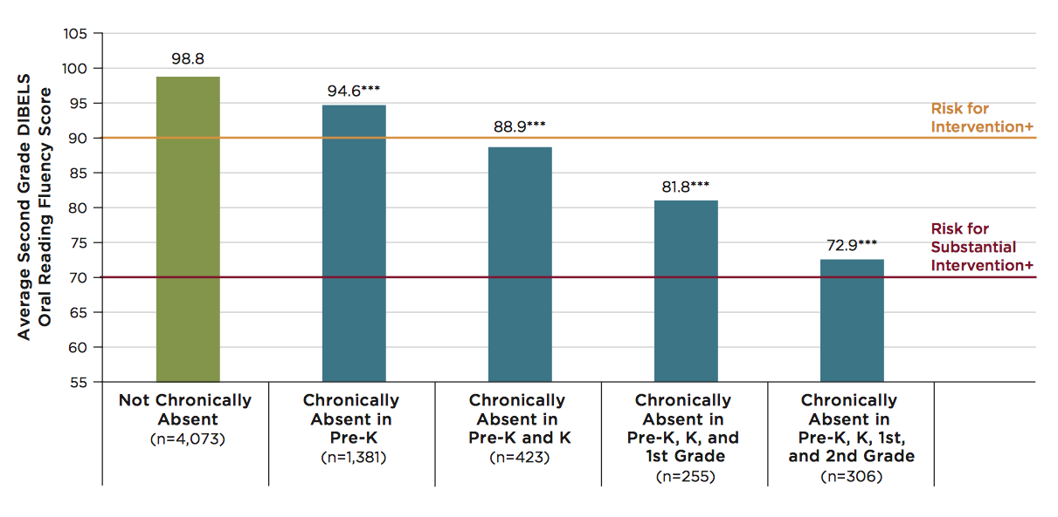
Multiple years of chronic absenteeism = high risk for low 3rd grade reading skills
Note: ***Indicates that scores are significantly different from scores of students who are never chronically absent, at p<.001 level. + In the DIBELS 6th Edition Assessment and Scoring Guide (Good & Kaminksi, 2002), these are labeled as “Some Risk,” indicating the need for additional intervention and “At Risk,” indicating the need for substantial interventions.
Notes:
The impact increases with multiple years of chronic absence. Experience indicates turning chronic absence around within 2 two years leaves a reasonable opportunity for students to recuperate academically from the lost time. Three consecutive years or more of chronic absence leaves gaping deficits. For principals this puts a very high priority on preventing or abating chronic absence from the outset of schooling.

Slide 11
Chronic Early Absence Connected to Poor Long Term Academic Outcomes
Chronic absence in kindergarten
Lower levels of
literacy in first grade
Lower achievement as far out as fifth grade
A Rhode Island Data Hub analysis found that compared to kindergartners who attend regularly, those chronically absent:
Scored 20% lower in reading and math in later grades and gap grows
2X as likely to be retained in grade.
2X likely to be suspended by the end of 7th grade.
Likely to continue being chronically absent
Notes:
Chronic early absence is the percentage of children in grades K-3 that miss 10% or more of the school year (or 18+ days in a 180-day school year).
Research shows that children who are chronically absent in kindergarten
Show lower levels of literacy in 1st grade
AND that chronic absence in kindergarten can predict lower achievement as far out as the 5th grade.
It is easy to overlook the prevalence of chronic early absence and think you don’t have an attendance problem if you only look at average daily attendance.
BUT in 2012, Rhode Island’s 4 core cities had an average daily attendance rate of 94%, BUT almost 1 in 5 students (19%) were chronically absent.
Chronic early absence can be reduced by using data to regularly identify and intervene with students who have multiple absences, engaging, educating and providing supports for families, personalizing the educational experience for all students, and educating communities to support school attendance.

Slide 12
Chronic absence is especially challenging for low-income children
Poor children are 4x more likely to be chronically absent in K than their highest income peers.
Children in poverty are more likely to lack basic health and safety supports (health care, transportation, stable housing, food, clothes, etc.) that ensure a child is more likely to get to school.
The adverse impact of absenteeism on literacy development is 75% greater for these children than for their middle class peers.
* (Romero & Lee 2007)

Slide 13
Chronic Absence =
A Solvable Problem

Slide 14
IV. Who Makes A Difference?
Children: When they get excited about coming to preschool every day and convey that enthusiasm to their parents and caregivers.
Families: When they understand that preschool absences matter, feel welcome and respected, value their children’s attendance and seek help as needed to overcome barriers.
Staff: When they create a positive first school experience and build attendance messaging, tracking, problem-solving and celebrating into preschool routine.
Community: When partners reinforce messaging and provide resources to help families overcome barriers to attendance.

Slide 15
V. What Can We Do?
Engage
Families
Engage
Preschoolers
Use Attendance
Data
Organize a Team

Slide 16
Engage Families
Welcome, involve and support families
Help families keep students healthy.
Use large gatherings to introduce the importance of preschool attendance and the need to monitor absences.
Use one-on-one conversations to reinforce the importance of attendance and identify challenges.
Continue messaging and recognition events all year long.
Prepare students and families for kindergarten transition.

Slide 17
Engage Families
The next three slides share examples of tools included in the toolkit to engage families.

Slide 18
Example 1:
Leverage Large Gatherings
(Use our handouts)

Slide 19

Example 2:
Leverage Large Gatherings
Bringing Attendance Home
Video (6 minutes)
Facilitated conversation
  The consequences of chronic absence
  How to improve absenteeism
    Family practice
    Increase social capital
    Identify how school can help
    Community services
http://www.attendanceworks.org/tools/for-parents/bringing-attendance-home-video

Slide 20
Example 3:
Encourage Families to Think @ My Help Bank
My Family – List who lives in your house
Everyday Helpers – Identify who you can call on to help drop your child off or who can pick him or her up. These are people like friends, neighbors, relatives who can help regularly.
Occasional Helpers – Identify people who probably cannot help every day, but can help in a pinch. Maybe it’s a god-parent, a relative or friend who lives outside your neighborhood but can be there for short stints.
Potential Helpers – Identify people who are part of your school community, church, or neighborhood who are able to help – if you ask.
My Family
Occasional Helpers
Potential Helpers
Everyday Helpers

Slide 21
Discussion
When could you introduce these materials (the video, the flyers, the help bank) in large gatherings or one on one conversations?

Slide 22
Engage Children
Greet Children and Families Warmly By Name Every Day
Establish Classroom Routines that Emphasize Attendance and Notice Absences
Engage Children in Tracking Their Own Attendance
Host Special Events To Recognize Children and Families for Good and Improved Attendance

Slide 23
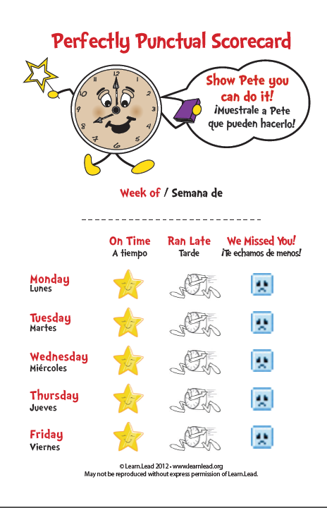
Engage Children in Tracking their Own Attendance
Daily:
  Children wear a button every day they arrive on time.
  Students fill out scorecards every morning upon arrival.
Weekly:
  The scorecards are sent home at the end of every week to reinforce the importance of consistent on-time attendance.
  Scorecard use heightens student awareness of their own attendance patterns and helps foster a sense of ownership and pride in their effort.

Slide 24
Discussion
Could your program use these tools to engage children in learning the importance of attendance?

Slide 25
Using Attendance Data
Do you track attendance?
Do you know how many children are chronically absent?
What level of absenteeism triggers a check in with the family?
What could you do to strengthen how you monitor absenteeism?

Slide 26
Organize A Team
Suggested Steps:
Create an attendance team.
Orient the team to research & best practices.
Create a plan to guide action that recognizes challenges, strengths and set priorities.
Engage teachers, social workers, parents & community partners in the work.

Slide 27
Discussion
Are there structures within your program that either already functions as an attendance team or could?

Slide 28

Chronic absence is like a warning light on your car dashboard
THANKS!
Any questions?
You can find me at @attendanceworks & hedy@attendanceworks.org
The Parallels:
Ignore it at your personal peril!
Address early or potentially pay more (lots more) later.
The key is to ask why is this blinking? What could this mean?

