Slide 1


BRINGING ATTENDANCE HOME
A Video Discussion Guide for Parents
www.attendanceworks.org

Slide 2
Group Norms
Create opportunities for everyone to participate
Respect different perspectives and experiences
Share only what you feel comfortable sharing. You can take a pass if you don’t want to share.
What would you add or change?

Slide 3
Icebreaker
What makes it hard for you as a parent to get your child or children to school every day?
What motivates and helps you to get your child to school despite these challenges?

Slide 4
Bringing Attendance Home:
A Video for Parents
http://www.attendanceworks.org/tools/for-parents/bringing-attendance-home-video/

Slide 5
Reactions to the Video
What do you think of the video’s statement about the consequences of chronic absence?
Chronic absence is missing 18 days of school over the course of a year, or just 2-3 days each month

Slide 6
A Summary of the Research
The next 5 slides show the impact of chronic absenteeism on student success.

Slide 7
Students Chronically Absent in Kindergarten and
1st Grade are Much Less Likely to Read Proficiently
in 3rd Grade
No risk | Missed less than 5% of school in K & 1st
Small risk | Missed 5-9% of days in both K & 1st
Moderate risk | Missed 5-9% of days in 1 year &10 % in 1 year
High risk | Missed 10% or more in K & 1st
Source: Applied Survey Research & Attendance Works (April 2011)
Notes:
This research conducted on a cohort of 640 students in San Mateo and Santa Clara offers evidence that chronic early absence can profoundly affect early school success. The bar on the far right shows only 17% of students chronically absent in both kindergarten and 1st read proficiently at the end of 3rd grade as compared to 64% of students who missed 5% or less of school in both K and 1.

Slide 8
The Long-Term Impact of Chronic Kindergarten Absence is Most Troubling for Poor Children
5th Grade Math and Reading performance by K attendance for children living In poverty. Academic performance was lower even if attendance had improved in 3rd grade.
Source: ECLS-K data analyzed by National Center for Children in Poverty (NCCP)
Note: Average academic performance reflects results of direct cognitive assessments conducted for ECLS-K.
Notes:
In any case, what we know is that that when children are young – it is children in poverty, who don’t have the resources to make up for time lost on task, who are affected most profoundly. In addition, children in poverty are more likely to face the kind of barriers– poor transportation, unstable housing or homelessness, lack of access to health care, etc. that cause children to be chronically absent for more than 1 year. This data suggests that we are losing some children as early as kindergarten. And, if they missed so much school that they aren’t reading by the end of 3rd grade, then even though attendance improves– they still fall behind or can’t catch up because they can’t read to learn. These children are likely to be the hardest to reach and help.

Slide 9
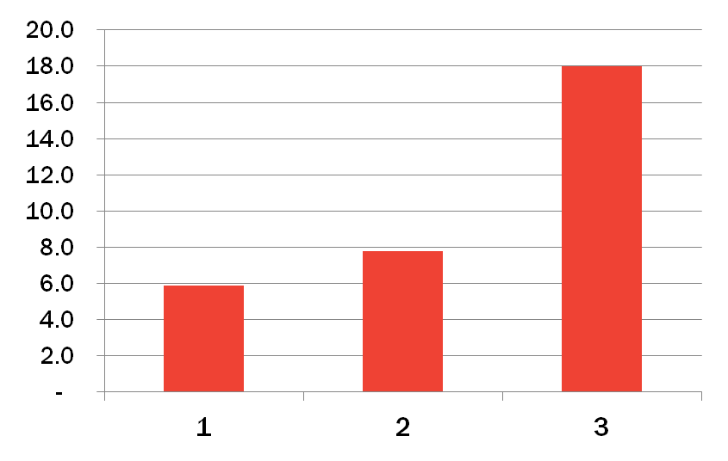
Multiple Years of Elementary Chronic Absence
= Worse Middle School Outcomes
Each year of chronic absence in elementary school is associated with a substantially higher probability of chronic absence in 6th grade
18.0x
Chronic absence in 1st grade is also associated with:
Lower 6th grade test scores
Higher levels of suspension
Increase in probability of 6th grade chronic absence
7.8x
5.9x
Years of Chronic Absence in Grades 1-5
Oakland Unified School District SY 2006-2012, Analysis By Attendance Works

Slide 10
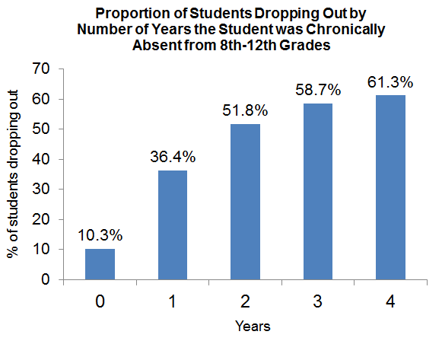
The Effects of Chronic Absence on Dropout Rates Are Cumulative
With every year of chronic absenteeism, a higher percentage of students dropped out of school.
http://www.utahdataalliance.org/downloads/ChronicAbsenteeismResearchBrief.pdf
Notes:
Hedy, I switched from the original display of the table to a bar chart.

Slide 11
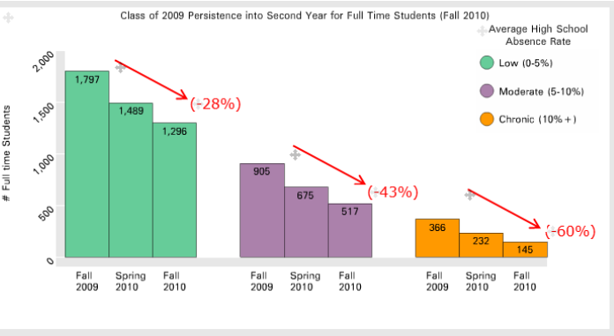
Chronic absence in high school predicts lower college persistence
In Rhode Island, only 11% of chronically absent high school students persisted into a 2nd year of college vs 51% of those with low absences.
Rhode Island Data Hub: May 2014

Slide 12
What Does It Take To Get a Child To School Every Day?
1. Family Practices
Families nurture a habit of attendance at home
2. Social Capital
Helpers who are relatives, friends, neighbors
4. Community Services
Availability of services like transportation, health services, affordable stable housing, etc.
3. Schools
Teachers, nurses, counselors, administrators, etc.

Slide 13
1. Family Practices
What are some things you already do to help get your child to school every day?
What are some reasons children might miss school and steps you can take to support your child’s attendance?
Some possible ideas…
  Set a regular bedtime and morning routine to make sure children get enough sleep and wake up ready for school
  Make medical appointments when school is not in session
  Avoid taking vacation when school is in session
  Send your child to school every day unless they are truly sick
  Develop backup plans for getting your child to school if something comes up

Slide 14
2. Social Capital
What are some ways you can think of to call on friends or other families to help you get your children to school? Who can you call on to consistently help? To occasionally help?
How can you help other families?

Slide 15
3. Schools
What are some ways our schools can help families with attendance?
How can we hold our schools accountable for attendance?

Slide 16
4. Community Services
Lack of reliable transportation or housing and health concerns are barriers that families cannot easily tackle alone. Do families in your school face these barriers to good attendance?
What are some other barriers that families in our school face?
What organizations offer services that can help address these barriers?

Slide 17

What is one key idea that you will take away with you and share with another parent?

Slide 18
Attendance Works thanks the W.K. Kellogg Foundation for supporting the production of this video and our work to improve student attendance. We also express gratitude to the Campaign for Grade Level Reading and the Annie E. Casey Foundation for their on-going support.
www.attendanceworks.org

