Slide 1


Reducing Chronic Absence
Why does it matter? What can we do?
Education Writers Association May 1, 2016 www.attendanceworks.org

Slide 2
Multiple Measures of Attendance
Average Daily Attendance
How many students show up to school every day? The percent of enrolled students who attend school each day. It is used in some states for allocating funding.
Truancy
Who is missing school without permission? Typically refers only to unexcused absences. Each state has the authority to define truancy and when it triggers legal intervention.
Who is missing so much school they are academically at risk? Broadly means missing too much school for any reason -- excused, unexcused, suspensions, etc. Researchers commonly define it as missing 10% of school. OCR currently defines it as missing 15 days and will be releasing a report in Spring 2016. Chronic absence is a required reporting metric in ESSA.
Chronic
Absence

Slide 3
Paradigm Shift
Truancy
- Counts unexcused absences
- Emphasizes compliance with school rules
- Focus on punitive, legal solutions
Chronic Absence
- Counts all absences
- Emphasizes academic impact of missed days
- Uses preventive strategies, positive messaging

Slide 4

Why Does Attendance Matter?
Attainment Over Time
Achievement Every Year
Attendance Every Day
Advocacy For All
4 A School Success Framework
  Developed by Annie E. Casey Foundation & America’s Promise Alliance
  For more info go to http://www.americaspromise.org/parent-engagement-toolkit

Slide 5
Improving Attendance Matters Because it Reflects:
  Exposure to language: Starting in Pre-K, attendance equals exposure to language-rich environments especially for low-income children.
  Time on Task in Class: Students only benefit from classroom instruction if they are in class.
  On Track for Success: Chronic absence in K and 1st grade is a proven early warning sign that a student will be behind in reading by 3rd grade, failing courses middle and high school, and likely to drop-out.
  College Readiness: Attendance patterns predict college enrollment and persistence.
  Engagement : Attendance reflects engagement in learning.
  Effective Practice: Schools, communities and families can improve attendance when they work together.
(For research, see: http://www.attendanceworks.org/research/)

Slide 6
Chronic Early Absence Connected to Poor Long- Term Academic Outcomes
Chronic absence in kindergarten
Lower levels of
literacy in first grade
Lower achievement as far out as fifth grade
A Rhode Island Data Hub analysis found that compared to kindergartners who attend regularly, those chronically absent:
Scored 20% lower in reading and math in later grades and gap grows
2X as likely to be retained in grade.
2X likely to be suspended by the end of 7th grade.
Likely to continue being chronically absent
Notes:
Chronic early absence is the percentage of children in grades K-3 that miss 10% or more of the school year (or 18+ days in a 180-day school year).
Research shows that children who are chronically absent in kindergarten
Show lower levels of literacy in 1st grade
AND that chronic absence in kindergarten can predict lower achievement as far out as the 5th grade.
It is easy to overlook the prevalence of chronic early absence and think you don’t have an attendance problem if you only look at average daily attendance.
BUT in 2012, Rhode Island’s 4 core cities had an average daily attendance rate of 94%, BUT almost 1 in 5 students (19%) were chronically absent.
Chronic early absence can be reduced by using data to regularly identify and intervene with students who have multiple absences, engaging, educating and providing supports for families, personalizing the educational experience for all students, and educating communities to support school attendance.

Slide 7
What type of data exists?
Chronic absence affects an estimated 1 out of 10 students nationwide and more than 1 out of 3 in some communities. Vulnerable, low-income communities often have higher levels in the early grades.
 | School District | State Department of Education | Federal Office of Civil Rights
Is attendance data collected? | Districts typically collect attendance data daily in their student information system. | Most states collect attendance by student at least annually in their longitudinal student data base. | OCR began collecting data on # of students missing 15 days in 2013-14.
Are chronic absence reports available? | Growing # calculate chronic absence rates, ideally by school grade, sub-population. Under ESSA, districts will be required to report. | Some calculate & publish on-line chronic absence rates (level of detail varies). | Will release chronic absence by school, district, state and sub-group in June/July 2016.
How can it be used? | To create real-time early warning systems and identify points of intervention. | To create accountability for addressing chronic absence to improve achievement | To assess if there is an unequal opportunity to learn.

Slide 8
How Can We Address Chronic Absence?

Slide 9
Unpack contributing factors to chronic absence
Myths
Absences are only a problem if they are unexcused
Sporadic versus consecutive absences aren’t a problem
Barriers
Lack of access to health or dental care
Aversion
Child struggling academically or socially
Bullying
Attendance only matters in the older grades
Poor Transportation
Trauma
No safe path to school
Ineffective school discipline
Parents had negative school experience
Disengagement
Lack of engaging and relevant instruction
No meaningful relationships with adults in school
Vulnerable to being with peers out of school vs. in school
Poor school climate
Undiagnosed disability
Homelessness

Slide 10
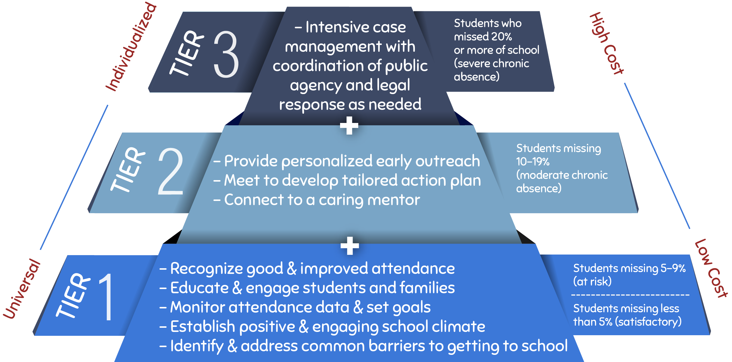
Invest in Prevention and Early Intervention

Slide 11
Take a Data Driven Systemic Approach
Positive Engagement:
Uses caring relationships, effective messaging and a positive school climate to motivate daily attendance.
Actionable Data:
Is accurate, accessible, and regularly reported in an understandable format.
Community
District
Positive Engagement
Actionable Data
Schools
Students & Families
Shared Accountability
Capacity Building
Capacity Building
Expands ability to work together to interpret data, engage in problem solving, and adopt best practices to improve attendance.
Shared Accountability:
Ensures chronic absence is monitoring & reinforced by policy
Strategic partnerships
between district and community partners address specific attendance barriers and mobilize support for all ingredients
Notes:
At same time, we know schools and communities can understand why kids aren’t in school and turn attendance around when they implement these five strategies with fidelity. How schools carry them out can be tailored to their own realities and strengths.
Then – I go through and offer examples of what each one of these might look like. I also clarify that recognizing good and improved attendance isn’t just providing perfect attendance awards for a semester or year– which doesn’t help to motivate improvement among the students with the most problematic attendance.

Slide 12

Consolidated School District
of New Britain, CT
Professional development: trained site administrators and teams to interpret attendance data, adopt best practices and engage in peer learning.
Actionable data: sent report to school(s) every 10 days. The report indicates how many and which students are chronically absent
School attendance teams: monitored the data and ensured appropriate supports are in place.
Home visits: hired two family intervention specialists to conduct home visits to chronically absent kindergartners.
Parent engagement and communications: messaged through newsletters, daily interactions with parents and attendance incentives.
Community partnerships: used community agencies to offer supports at school sites and through a district Attendance Review Committee formed as a diversion to juvenile court and referral to the Department of Children and Families.

Slide 13
Consolidated School District
of New Britain, CT

Slide 14
Possible Reporting Ideas
Increase awareness that chronic absence is an overlooked challenge affecting achievement, especially for our most vulnerable students
Deepen understanding of causes of chronic absence and potential solutions
Inspire action by highlighting bright spots showing what works

