Slide 1
Bringing Attendance Home
Engaging Parents and Students in Reducing Chronic Absence
Nashville TN September 30, 2015

Slide 2
Warm-Up Exercise ~ Quick Write
One story about how you helped a student or a school improve attendance?
What did you learn from that experience about what works?
What was hard? What barriers did you face?
Notes:
Hedy--Acknowledge past year of work. Write individually. 3-4 share out loud.

Slide 3
Agenda
Review of the Research and Key Concepts
Parent Perceptions of Attendance
Apply Tier I Interventions and Tools
  Attendance Incentives
  Illustrating the Gap
  Bringing Attendance Home Video
  Student Attendance Success Plan
  Written Materials
  Leveraging Parent/Teacher Conferences
  Reflections
Notes:
Teneh
Barriers

Slide 4
Learning Goals for Today
Reflect on why chronic absence matters for student success and how family engagement is a critical ingredient for turning it around.
Find out about the latest research about what works for messaging attendance to families
Take away strategies and tools for engaging families in conversations about why attendance matters and what they can do
Identify opportunities to use these materials in your own schools and communities

Slide 5
Attendance Research & Concepts
A Quick Review

Slide 6
Attendance is An Essential Ingredient of Academic Success
Attainment Over Time
Achievement Every Year
Attendance Every Day
Advocacy For All
4 A School Success Framework
  Developed by Annie E. Casey Foundation & America’s Promise Alliance
  For more info go to http://www.americaspromise.org/parent-engagement-toolkit

Slide 7
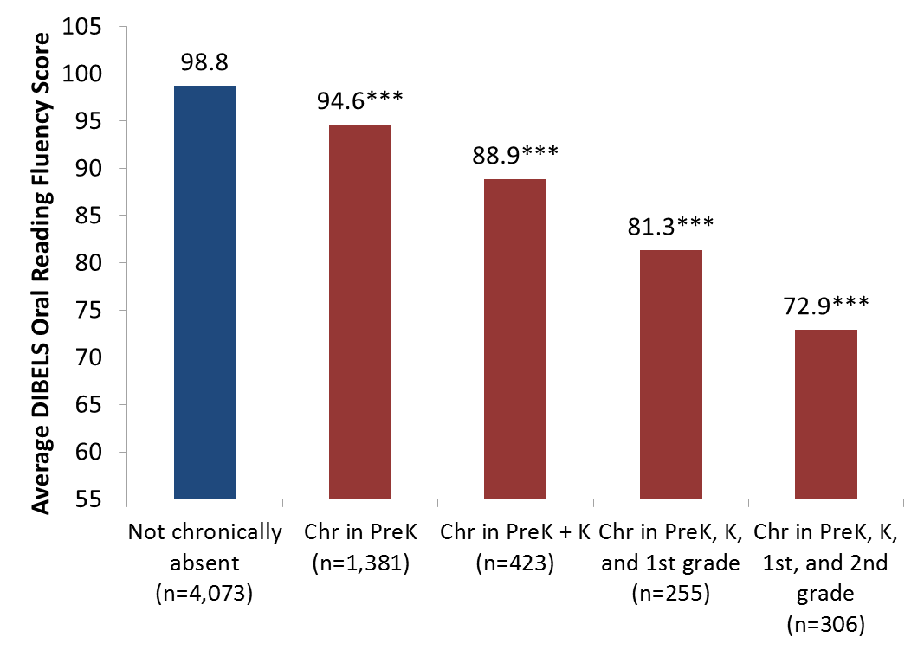

Starting in PreK, More Years of Chronic Absence = Need for Intensive Reading Support By 2nd Grade
Some risk
At risk
* Indicates that scores are significantly different from scores of students who are never chronically absent, at p<.05 level; **p<.01; ***p<.001
Notes:
*** This is a group that schools than focus on intervening with. We know that these are more disadvantaged students, but here is a specific indicator – whether they are chronically absent (particularly once they move from prek into K) that schools that use to focus their outreach efforts.
See the stair step pattern. Every year of absence correlates with lower achievement. By the end of 2nd grade.. The kids with persistent chronic absence are in need of serious reading intervention.

Slide 8
The Long-Term Impact of Chronic Kindergarten Absence is Most Troubling for Poor Children
5th Grade Math and Reading performance by K attendance for children living In poverty. Academic performance was lower even if attendance had improved in 3rd grade.
Source: ECLS-K data analyzed by National Center for Children in Poverty (NCCP)
Note: Average academic performance reflects results of direct cognitive assessments conducted for ECLS-K.
Notes:
In any case, what we know is that that when children are young – it is children in poverty, who don’t have the resources to make up for time lost on task, who are affected most profoundly. In addition, children in poverty are more likely to face the kind of barriers– poor transportation, unstable housing or homelessness, lack of access to health care, etc. that cause children to be chronically absent for more than 1 year. This data suggests that we are losing some children as early as kindergarten. And, if they missed so much school that they aren’t reading by the end of 3rd grade, then even though attendance improves– they still fall behind or can’t catch up because they can’t read to learn. These children are likely to be the hardest to reach and help.

Slide 9
Chronic Early Absence Connected to 3rd Grade-Level Reading
Chronic absence in kindergarten
Lower levels of literacy in first grade
Lower achievement as far out as fifth grade
A Rhode Island Data Hub analysis found that compared to kindergartners who attend regularly, those chronically absent:
  Scored 20% lower in reading and math in later grades
  and gap grows
  2x as likely to be retained in grade.
  2x likely to be suspended by the end of 7th grade.
  Likely to continue being chronically absent
Notes:
Chronic early absence is the percentage of children in grades K-3 that miss 10% or more of the school year (or 18+ days in a 180-day school year).
Research shows that children who are chronically absent in kindergarten
Show lower levels of literacy in 1st grade
AND that chronic absence in kindergarten can predict lower achievement as far out as the 5th grade.
It is easy to overlook the prevalence of chronic early absence and think you don’t have an attendance problem if you only look at average daily attendance.
BUT in 2012, Rhode Island’s 4 core cities had an average daily attendance rate of 94%, BUT almost 1 in 5 students (19%) were chronically absent.
Chronic early absence can be reduced by using data to regularly identify and intervene with students who have multiple absences, engaging, educating and providing supports for families, personalizing the educational experience for all students, and educating communities to support school attendance.

Slide 10


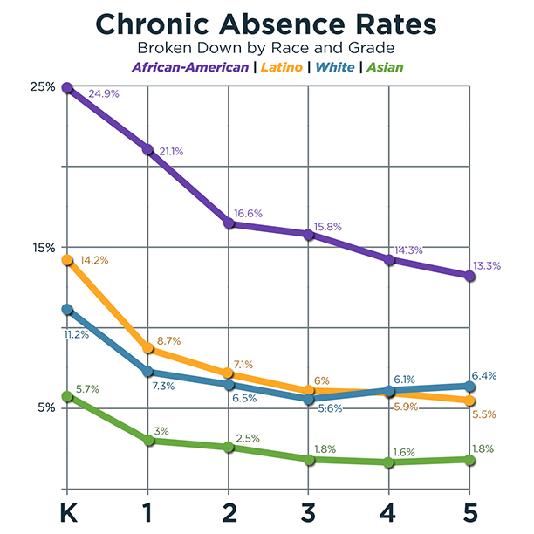
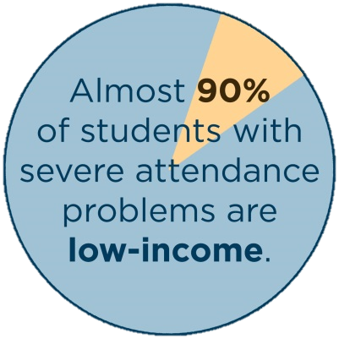
Disadvantaged Youth Suffer Greater Disparities

Slide 11
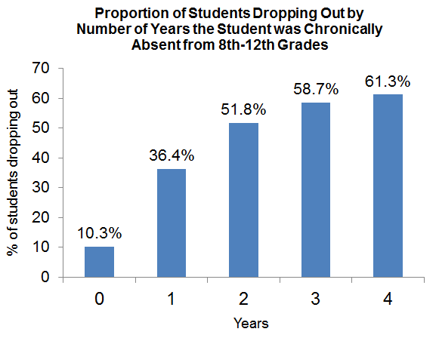
The Effects of Chronic Absence on Dropout Rates Are Cumulative
With every year of chronic absenteeism, a higher percentage of students dropped out of school.
http://www.utahdataalliance.org/downloads/ChronicAbsenteeismResearchBrief.pdf
Notes:
This is data from Utah– by middle school – chronic absence is sure fire indicator of drop out across students of all backgrounds. They found just one year of chronic absence – anytime between 8th and 1st grade -was associated with 3 times higher levels of drop out . Two years– and over half dropped out.

Slide 12
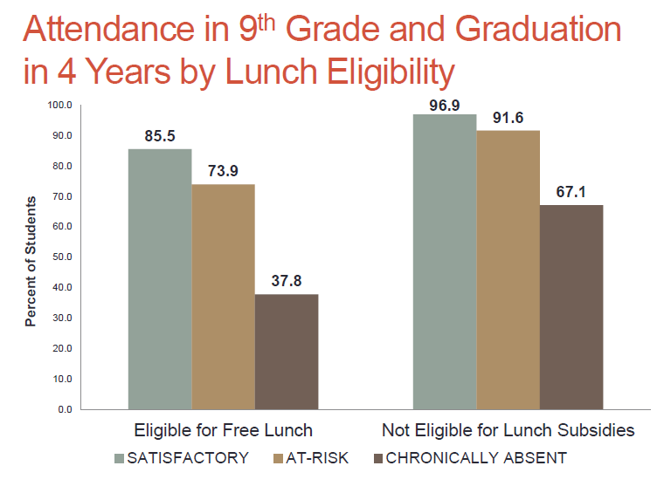
Attendance Is Even More Important for Graduation for Students In Poverty
Presentation to: The Interagency Council for Ending the Achievement Gap November 7, 2013, CT State Dept of Education.

Slide 13
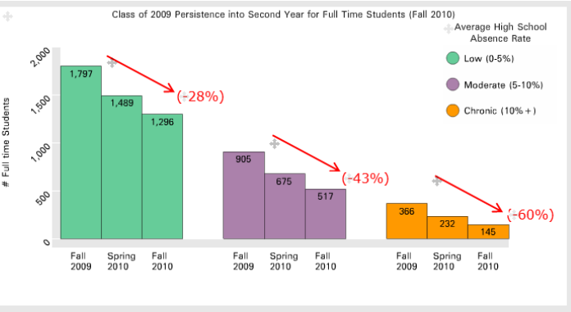
Chronic Absence in High School Predicts Lower College Persistence
In Rhode Island, only 11% of chronically absent high school students persisted into a 2nd year of college vs. 51% of those with low absences.
Rhode Island Data Hub: May 2014

Slide 14
Find Out Why Students Are Chronically Absent
Barriers
Lack of access to health or dental care
Poor
Transportation
Aversion
Child struggling academically
Absences are only a problem if they are unexcused
Lack of engaging instruction
Poor school climate and ineffective school discipline
No safe path to school
Parents had negative school experience
Attendance only matters in the older grades
Sporadic versus consecutive absences aren’t a problem
Myths
Trauma
Chronic disease
Notes:
The good news is that chronic absence is a solvable problem. But knowing what will do the trick– requires understanding what leads to a student not coming to school. There are three major kind of reasons that students don’t go to school. It starts not with not making assumptions but taking the time to find out why a student or students are missing school. And, we have found it helpful to think about the possibilities in these big buckets. (Then go through some of the issues)
Remind people that aversion isn’t always a big issue. Among young children, aversion may be a matter of separation anxiety– the nervousness that a young child feels if he or she is going to be cared – for the first time - by someone who isn’t a family member. What by the way– do you think kids say when they are nervous or anxious about going to school? Mommy, I have a stomach ache… So then sometimes you make think this is a barrier related to health– when the issue is really aversion.
By the same token- it is important to keep in mind aversion can reflect much more serious systemic challenges such as poor school discipline policies that are pushing students out of school. Do you realize some places still, for example, suspend students for being truant?
Data combined with the insights of student and families can help you understand what are the causes of absences. If chronic absence is concentrated in a neighborhood - see if there are safety or transportation issue. Or find out if chronic absence is associated with high levels of asthma, could it be poorly controlled asthma or families not feeling secure about the ability of school to deal with an asthma attack. If chronic absence is concentrated in a classroom – it could be a matter of poor and boring instruction. Or, perhaps a teacher struggling with a bullying issue and in need of support.

Slide 15
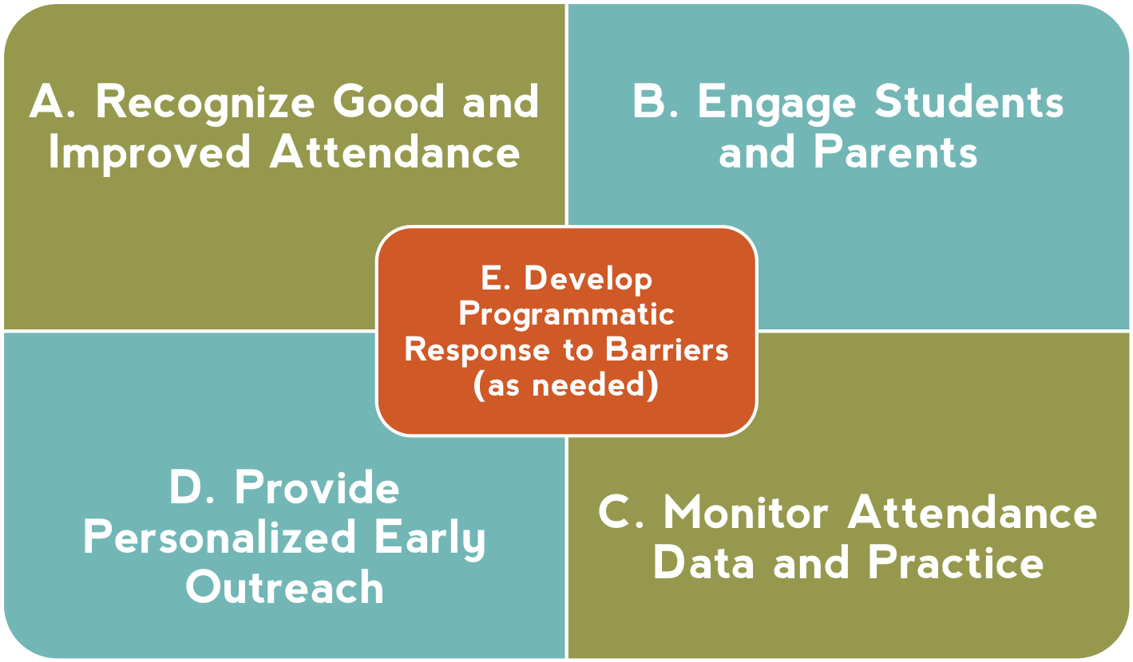
AW Recommended Site-Level Strategies
Notes:
These five site based strategy– help to ensure an investment in the first two tiers– recognizing good and improved attendance as well as parent and student engagement as a part of tier 1 universal approaches for all students and their families. Recognizing good and improved attendance isn’t just providing perfect attendance awards its about ensuring that all students and families understand what good attendance is and that students and families who make an effort to turn around problematic absences get noticed. Personalized early outreach ensures intervention happens early when a student first becomes chronically absent. Monitoring attendance data and practice ensures that you know which students are at-risk for chronic absence missing just two days a month so that intervention can happen early. And Developing programmatic responses to barriers involves understanding common barriers to student attendance and implementing an effective strategies to address the barriers, such as a school in California that learned that a group of students were chronically absent because their parents worked the night shift at a nearby factory and were falling asleep. In response after talking with families the school instituted a breakfast program. Schools have successfully turned chronic absence around when they implement these five strategies with fidelity. How schools carry them out can be tailored to their own realities and strengths. The key to this work is relationships with students, families and each other to successfully combat this epidemic.

Slide 16
Improving Attendance Requires a
Multi-Tiered Approach
TIER 3 Students who missed 20% or more of the prior school year (severe chronic absence) or were chronically truant.
Intensive case management with coordination of public agency and legal response as needed
High Cost
Truancy interventions
TIER 2 Students exhibiting chronic absence (missing 10%) or receiving 3 NOTs.
Provide personalized early outreach
Meet with student/family to develop plan
Offer attendance Mentor/Buddy
TIER 1
All students
Recognize good and improved attendance
Educate & engage students and families
Monitor attendance data
Clarify attendance expectations and goals
Establish positive and engaging school climate
Identify and address common barriers to attendance
Low Cost
Notes:
Improving attendance requires a 3 tiered approach. The challenge is that too many schools and communities are failing to invest in the first two tiers of universal and preventative. The strategies we just outlined– help to ensure an investment in the bottom two tiers – recognizing good and improved attendance as well as parent and student engagement are part of universal approaches. Personalized early outreach ensures intervention happens early. Investing in these bottom tiers is both more effective and less costly. And, if schools don’t, then the top of the pyramid becomes easily becomes overwhelmed.

Slide 17
Additional Information about Parent Perceptions of Attendance

Slide 18



Ad Council – CA Attorney General Reducing Chronic Absence by Informing Parents

Slide 19
1
Parents Have Only the Best Intentions
How likely are you to do the following in the 2015-16 school year?
90%
93%
92%
91%
82%
65%
Very
Likely
Somewhat Likely
During both phases of research, it was absolutely clear that parents have big dreams for their children and have the best intentions.
19

Slide 20
2
Parents Don’t Think Early Grade Absences Are a “Big Deal”
% who say “it’s a big deal to miss at this grade level”
Spanish-Speaking Parents
English-Speaking Parents
Parents are about 2x more likely to say that attendance is a “big deal” in high school than kindergarten
20

Slide 21
Messaging: Absences v. Attendance
Associations
Perceptions
Potential Impact
Change in behavior
Absences
Associate with what child is missing
This behavior is planned so makes parents think about impact of planned absences
Reinforces current behavior
Attendance
Associate with what child is already gaining
This behavior considered automatic, makes parents feel like they are already doing

Slide 22
Parents Underestimate the Number
of Year-End Absences
We asked each parent about his or her child’s absences in two ways:
Was your child absent an average of 2 or more days a month?
Was your child absent more than 10 days over the year?
60% of parents said their child was absent an average of 2+ days a month, but not 10+ days a year
Missed an average of
2+ days per month
90%
Missed
10+ days annually
30%
The math: If a child is absent an average of 2+ days a month, then she is absent far more than 10+ days a year
22

Slide 23
Most High-Absence Parents Reported
that Their Schools Had Not Contacted Them
Only 42% reported that a school official, including a teacher, contacted them about attendance in the last 6 months.
72% of parents reported that they most trust teachers to talk to them about absences.
BUT
We need to make it easier for teachers and school leaders to talk to parents about absences.
23

Slide 24
4
Schools Inadvertently Reinforce
Some Absence-Causing Beliefs
School Behaviors that…
Reinforce Attendance |  | Reinforce Absenteeism
Class rewards for good attendance (e.g. popcorn or ice cream parties) Individual recognition for students with good attendance |  | Impersonal letters Teachers send work home in response to absences Teachers do not address absenteeism issue with the parent Parents do not feel their child is safe in school High levels of absenteeism in the class
Impersonal Letters:
Easy to disregard
Many parents felt the school miscounted—but parents couldn’t verify because they weren’t tracking absences
Many parents felt that the school didn’t understand them
Sending Work Home:
Parents thought that completing a makeup packet caught their child up for the missed day’s work
Teachers Not Addressing Absenteeism:
Most parents reported that they regularly communicate with their children’s teacher, but never about absences
Big motivators for kids,
but not parents
Reinforces parents’ existing attitudes and behaviors toward absences

Slide 25
Reflections
What do you think about these findings about parent’s attitudes about attendance and absence?
What are potential implications for your own work?

Slide 26
Tier 1 Interventions

Slide 27
Tiered Approach to Improving Attendance
TIER 3
Students at risk of missing 20% or more of
school (severe chronic absence)
Intensive education case management with coordination of public agency and legal response as needed
High Cost
TIER 2
Students at risk of missing 10-19% (moderate chronic absence)
Provide personalized early outreach
Meet with student/family to develop plan
Outreach to students with health challenges
Offer attendance Mentor/Buddy
TIER 1
All students
Recognize good and improved attendance
Educate & engage students and families
Monitor whether absences are adding up
Clarify attendance expectations and goals
Establish positive and engaging school climate
Low Cost
Notes:
Improving attendance requires a 3 tiered approach. The challenge is that too many schools and communities are failing to invest in the first two tiers of universal and preventative. The strategies we just outlined– help to ensure an investment in the bottom two tiers – recognizing good and improved attendance as well as parent and student engagement are part of universal approaches. Personalized early outreach ensures intervention happens early. Investing in these bottom tiers is both more effective and less costly. And, if schools don’t, then the top of the pyramid becomes easily becomes overwhelmed.

Slide 28
What Families Does Tier 1 Help?
Families of all students enrolled in your school or program
Families who partner with school when given the necessary tools and strategies.
Families who have had good experiences with school in the past.
Notes:
Cecelia and Teneh

Slide 29

Tier 1: Communication, Education, and Engagement
29
Notes:
We also have tool kits. The parent engagement toolkit includes exercises to demonstrate the difference absenteeism makes on academic achievement and the teaching attendance toolkit includes strategies for entwining attendance messaging with pre-existing school communication and engagement strategies.

Slide 30
Tips for Attendance Incentives
Should be part of a more comprehensive approach.
Simple, no-cost rewards - recognition, special privileges, personal connection - work. Reward families, not just students.
Interclass competition is a powerful motivator.
Avoid recognizing only perfect attendance.
Reward timeliness.
Keep families informed and engaged, not just students.

Slide 31
Nurture a culture of attendance in your schools and community
Send home handouts * with information and tips about attendance. See http://www.attendanceworks.org/tools/for-parents/
Talk with parents and students early in the school year or, during the summer to share the value of good attendance and let them know that you are there to help.
Consider using an exercise to demonstrate the importance of attendance. Ask parents to sign a pledge card.
  (* = low hanging fruit!)

Slide 32




Illustrating the Gap Exercise
For directions,
see page 17 of Bringing Attendance Home Toolkit

Slide 33

Parent Video & Discussion Guide
Setting the stage
VIDEO (6 minutes)
Facilitated conversation
  The consequences of chronic Absence
  How to improve absenteeism
    Family practice
    Increase social capital
    Identify how school can help
    Community services
Discussion: What are your reactions to the video? When and where might you use these materials with a family or a group?
Notes:
Cecelia

Slide 34
Student Attendance Success Plan
These elements help a family to
  Develop back up plans
  Set an attendance goal
  Keep track of absences
  Come up with ideas for supporting attendance at home
Tip: Start with the Help Bank and Calendar – offer the first page for homework.
34

Slide 35
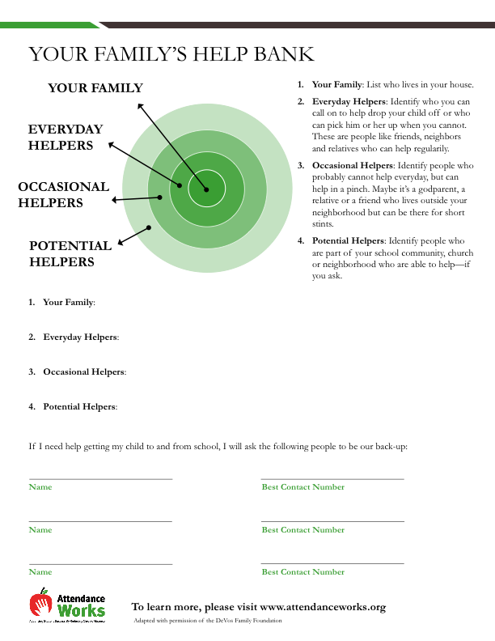
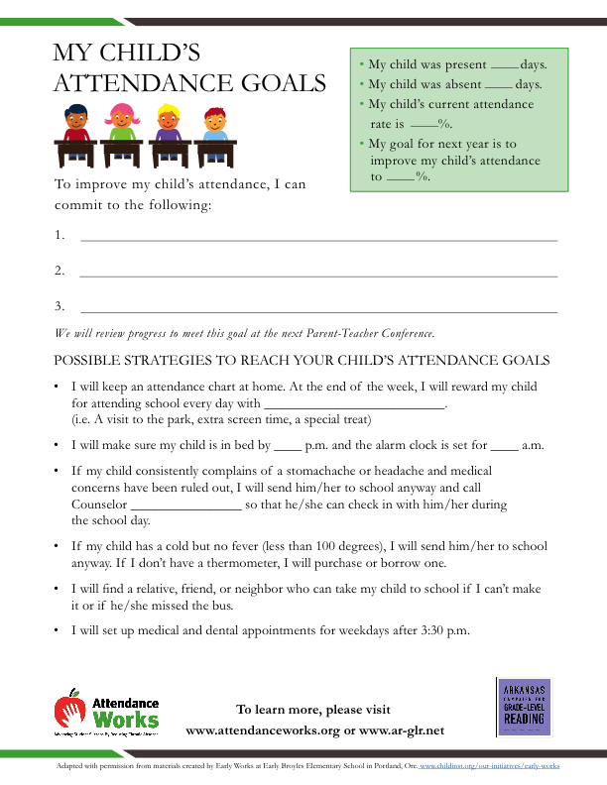
Make Creating Back Up Plans a Norm:
Student Attendance Success Plan

Slide 36
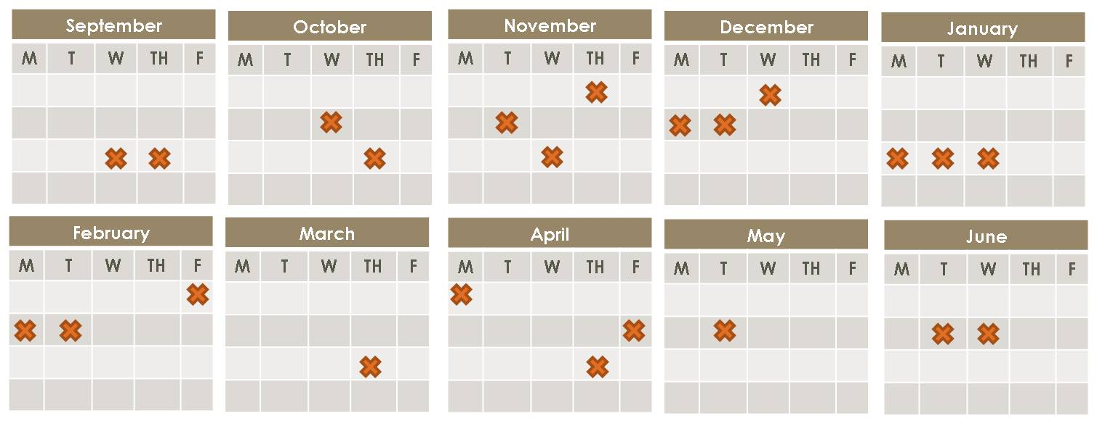
Keep Track of Attendance
Absences Add Up!
Chronic Absence = 18 days of absence = As Few As 2 days a month
Notes:
It’s easy not to notice when your child may be missing too much school. 10% of a school year is about 18 days of absence. That sounds like a lot but when you break it down, that’s just two days a month. Most parents don’t get too stressed out if their child misses two days of class in a month. But when it happens month after month, it becomes a problem. Why?

Slide 37
Discussion
When might you introduce the video and possibly the Student Attendance Success Plan?
37

Slide 38
Leveraging Parent-Teacher Conferences to Inform Families
Satisfactory Attendance
At-Risk
Chronic Absence
Missing less than 5% of school days
Missing between 5-10% of school days
Missing 10% or more of school days

Slide 39
Your Turn
Satisfactory Attendance
At-Risk
Chronic Absence
Q: It’s the end of the first semester and 90 school days have gone by.
What does it mean for a student to be in the Satisfactory Attendance category?
A: Student has missed 4 or fewer school days (in other words, less than 4.5 days)

Slide 40
Your Turn
Satisfactory Attendance
At-Risk
Chronic Absence
Q: It’s the end of the first semester and 90 school days have gone by.
You meet with a student who was absent 8 days in the first semester. What category is she in?
A: Student is in the At-Risk category
(8/90 = 8.9% absence rate)

Slide 41
Attendance Categories: Recapped
Good Attendance
Student has missed fewer than 5% of school days (generally less than 4 or 5 days in a semester)
At-Risk
Student has missed between 5% and 10% of school days (generally between 5-9 days in a semester)
Chronic Absence
Student has missed 10% or more of school days (generally 9 days or more in a semester)

Slide 42
What might educators and community partners say to families?
Satisfactory Attendance
At-Risk
Chronic Absence
If student is right around 10% or a little above
Let parents know their child may be academically at risk because they have missed so much school. Discuss underlying causes and how you can help.
If student is severely chronically absent (e.g. >20%)
The type of challenges these families face may differ from those with more moderate absence problems. Be prepared to touch on difficult topics, be supportive, and be ready to connect to community resources.
Congratulate parents on making attendance a priority and encourage them to keep it up. Ask them what they’re doing that’s enabling them to be so successful.
Let parents know that you are concerned about attendance because their child is beginning to head off track, and it is easy for absences to add up.

Slide 43
Talking to Families about Absences: A Role Play
Teacher Perspective: It’s October and Alyssa has already missed 8 days of school and is frequently tardy. The teacher has noticed that Alyssa seems more reserved and less attentive than normal in class.
Mother’s Perspective: Alyssa has asthma and its causing her to miss school. Alyssa is not skipping school without permission so these absences aren’t a problem.
Notes:
Invite two new volunteers to play the role of teacher and parent.

Slide 44
Framing the Conversation to Build a Relationship of Trust
1
Learn
Learn about the student’s family. Ask what their vision is for their child’s future. What are their hopes and dreams for them?
2
Share
Share positive things you’ve observed about the student. Share your own vision for student learning & development, including helping put students on a pathway to success by encouraging a habit of good attendance.
3
Inform
Review attendance report with parents. Tailor your conversation to student’s level of absenteeism and inform parents of possible impacts of missing school. Connect attendance back to parents’ hopes and dreams for their child.
4
Discuss
Discuss the challenges parents face in getting their children to school, as well as strengths they can build upon. For chronically absent students, try to understand the barriers that are keeping their children from school.
5
Arrive at a Plan
Think through strategies with parents for addressing absences and help them develop an attendance improvement plan. Offer referrals to services as needed and ask if there are other ways you can help.

Slide 45

Reflections
Head – a thought inspired by today
Heart – a feeling evoked by today
Hand – an action you will take

