Slide 1
Reducing Chronic Absence: What Will It Take?
An overview of why it matters and key ingredients for improving student attendance
Hedy Chang, Director
Spring 2014

Slide 2
Unpacking Attendance Terms
Average Daily Attendance
The % of enrolled students who attend school each day. It is used in some states for allocating funding.
Truancy
Typically refers only to unexcused absences and is defined by each state under No Child Left Behind. It signals the potential need for legal intervention under state compulsory education laws.
Chronic Absence
Missing 10% or more of school for any reason -- excused, unexcused, etc. It is an indication that a student is academically at risk due to missing too much school starting in Kindergarten.
Notes:
Unpacking attendance terms is critical because the word attendance encompasses multiple measures – each of which mean something different. If we aren’t clear about which attendance measure we are using, we can easily get confused and think we are talking about the same thing when we are not. Here are three of the most common measures. The first is ADA– which refers to the % of students who show up to school every day. It is often used for funding because it helps us know for example –how many desks do I need in my school in order to accommodate the typical number of students who show up every day. The second term is truancy – which typically refers only to unexcused absences. But, keep in mind truancy is defined differently across states In Maryland for example it is missing 20% of the school year due to unexcused absences. In California, it is a child who misses any 3 days without a valid excuse or is late to class by 30 minutes 3 times. In California, this low truancy figure triggers a note home so that parents know their child has been missing school. In many state, truancy is missing 10 days without an excuse. Regardless of the definition, truancy is typically used to begin identifying when a student may be breaking state compulsory education laws and to trigger the beginning of legal intervention. Chronic absence is a new term that Attendance Work has been promoting. It is based upon research. And, shows when has a child missed so much school that they are academically at risk.

Slide 3
High Levels of ADA Can Mask Chronic Absence
90% and even 95% ≠ A
98% ADA = little chronic absence
95% ADA = don’t know
93% ADA = significant chronic absence
Notes:
Likewise, it is important to recognize the limitation of monitoring average daily attendance. Let’s say for example, you have a school with 200 students. If 190 show up to school – that is 95% attendance. But the 10 students who missed school that day are not the same 10 kids throughout the year. 95% attendance could be masking the fact that there are 60 students -- each of whom is missing about a month of school. . It all depends whether absences are due to most students missing a few days or excessive absences among a small but still significant minority of students. This slide shows variations in chronic absence across elementary schools in Oakland – all of whom had 95 – 95.5% Average Daily Attendance .

Slide 4
Truancy (unexcused absences) Can Also Mask Chronic Absence
Notes:
Here is a comparison of chronic absence and truancy – kids who missed 10 days without an excuse by near the end of a school year in San Franiisco. Take a look at kindergarten. chronic absence identified twice as many students than if they only looked at the truancy data.

Slide 5
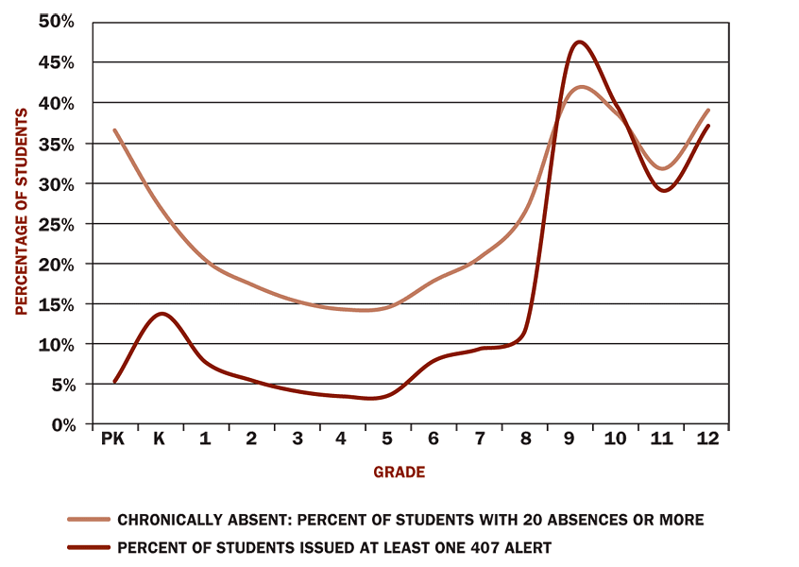
Sporadic – Not Just Consecutive – Absences Matter
New York City Schools (2008)
A 407 alert is issued when a student misses 10 consecutive days or 20 days over a 40 day period. It misses more sporadic absence.
1 out of 5 elementary school children were chronically absent.
Source: Nauer, K. et al, Strengthening Schools by Strengthening Families, Center for New York City Affairs New School, Oct 2008
Notes:
Another reason chronic absence is overlooked is children don’t always miss too much school because of consecutive days of absence. Rather they miss – for example– one day every two weeks – which might be harder to track especially given the large size of classes these days. But these sporadic absences can still add up to too much time of lost instruction.
In New York, they were surprised to see chronic absence had been masked by the 407 process which had been created to address concerns about child abuse when a child– Nixmary Brown had been found dead in the basement. At the time, everyone asked didn’t anyone at school notice. The 407 alert is important– but it is not the same as identifying students at academic risk because they’ve missed too much school.

Slide 6
Chronic Absence: A Hidden National Crisis
Nationwide, as many as 10-15% of students (7.5 million) miss nearly a month of school every year. That’s 135 million days of lost time in the classroom.
In some cities, as many as one in four students are missing that much school.
Chronic absenteeism is a red alert that students are headed for academic trouble and eventually for dropping out of high school.
Poor attendance isn’t just a problem in high school. It can start as early as kindergarten and pre-kindergarten.

Slide 7
The Campaign for Grade-Level Reading
The Campaign for Grade-Level Reading is focusing on three challenges to reading success that are amenable to community solutions:
The Readiness Gap: Too many children from low-income families begin school already far behind.
The Attendance Gap (Chronic Absence): Too many children from low-income families miss too many days of school.
The Summer Slide (Summer Learning Loss): Too many children lose ground over the summer months.
Notes:
Its profound impact on early learning is why chronic absence is considered one of the 3 key pillars of the comprehensive approach to reading at 3rd grade espoused by the Campaign for Grade Level Reading -- along with reducing the gap in school readiness and reducing summer learning loss. This strategy offers ways for communities to partner with schools to move the needle on 3rd grade reading – even while longer term efforts to improve the quality instruction of classroom instruction take place.
Note– this is often where I will do the reading gap exercise in Bringing Attendance Home.

Slide 8
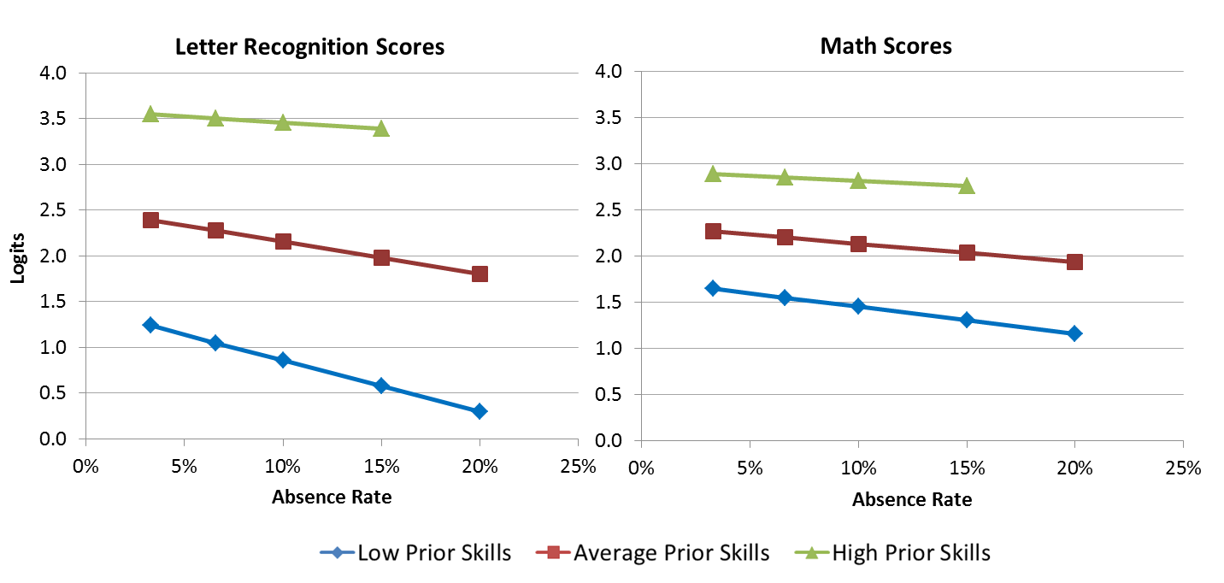
Starting in preK, chronic absence affects learning and school readiness. Attendance matters most for the children who enter the farthest behind.
Analyses control for prior preschool experience, race, gender, neighborhood poverty and social status, special education status, ELL status, and program type. Missing data points represent values with fewer than 30 students.
Notes:
So, children who enter preschool with lower prior knowledge are more likely to be absent more, and the more they are absent, the lower their scores are. You can see this by the steeper slope of the blue curve at the bottom. The kids who need it the most too often get the least….

Slide 9
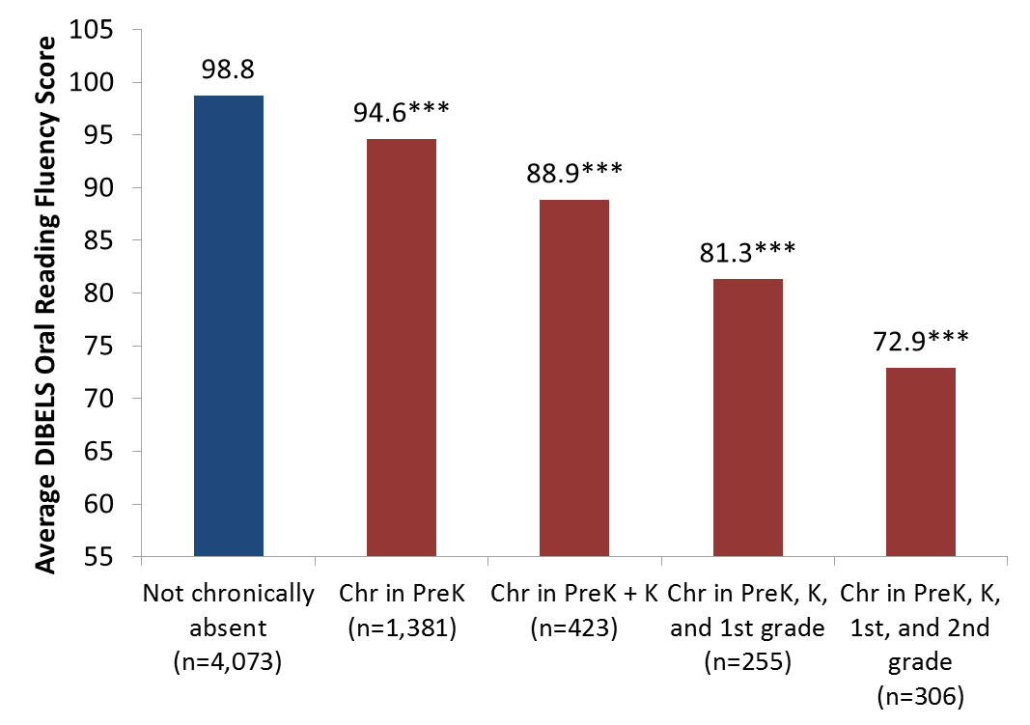
Students with more years of chronic absenteeism, starting in preK have lower 2nd grade scores
Some risk
At risk
* Indicates that scores are significantly different from scores of students who are never chronically absent, at p<.05 level; **p<.01; ***p<.001
Notes:
*** This is a group that schools than focus on intervening with. We know that these are more disadvantaged students, but here is a specific indicator – whether they are chronically absent (particularly once they move from prek into K) that schools that use to focus their outreach efforts.
See the stair step pattern. Every year of absence correlates with lower achievement. By the end of 2nd grade.. The kids with persistent chronic absence are in need of serious reading intervention.

Slide 10
Students Chronically Absent in Kindergarten and 1st Grade are Much Less Likely to Read Proficiently in 3rd Grade
No risk | Missed less than 5% of school in K & 1st
Small risk | Missed 5-9% of days in both K & 1st
Moderate risk | Missed 5-9% of days in 1 year &10 % in 1 year
High risk | Missed 10% or more in K & 1st
Source: Applied Survey Research & Attendance Works (April 2011)
Notes:
This research conducted on a cohort of 640 students in San Mateo and Santa Clara offers evidence that chronic early absence can profoundly affect early school success. The bar on the far right shows only 17% of students chronically absent in both kindergarten and 1st read proficiently at the end of 3rd grade as compared to 64% of students who missed 5% or less of school in both K and 1.

Slide 11
The Long-Term Impact of Chronic Kindergarten Absence is Most Troubling for Poor Children
5th Grade Math and Reading performance by K attendance for children living In poverty. Academic performance was lower even if attendance had improved in 3rd grade.
Source: ECLS-K data analyzed by National Center for Children in Poverty (NCCP)
Note: Average academic performance reflects results of direct cognitive assessments conducted for ECLS-K.
Notes:
In any case, what we know is that that when children are young – it is children in poverty, who don’t have the resources to make up for time lost on task, who are affected most profoundly. In addition, children in poverty are more likely to face the kind of barriers– poor transportation, unstable housing or homelessness, lack of access to health care, etc. that cause children to be chronically absent for more than 1 year. This data suggests that we are losing some children as early as kindergarten. And, if they missed so much school that they aren’t reading by the end of 3rd grade, then even though attendance improves– they still fall behind or can’t catch up because they can’t read to learn. These children are likely to be the hardest to reach and help.

Slide 12
Multiple Years of Elementary Chronic Absence
= Worse Middle School Outcomes
Each year of chronic absence in elementary school is associated with a substantially higher probability of chronic absence in 6th grade
18.0x
Chronic absence in 1st grade is also associated with:
Lower 6th grade test scores
Higher levels of suspension
Increase in probability of 6th grade chronic absence
7.8x
5.9x
Years of Chronic Absence in Grades 1-5
Oakland Unified School District SY 2006-2012, Analysis By Attendance Works
Notes:
This shows why we need to start tracking chronic absence as early as possible. WE fo und that being chronically absent in 1st grade was associated with 5.8 – nearly six times higher chronic absence in 6th grade. Lower test scores and higher suspensions. If a child was chronically absent any three years– then they had 18 times higher levels of chronic absence!! There are other kids who fall off track in middle or high school– something happens even though they did OK in elementary school that results in their not showing up regularly. But the kids who are most expensive to bring back – we possibly lost in K and 1st – and because we were looking at truancy- -we didn’t notice that they or their families needed our help. We missed the opportunity to interrupt chronic absence before– they are so far behind and already feeling that school is not a place where they can succeed.
Do you know what the single highest predictor of chronic absence is? It isn’t race, it isn’t income – it is prior year chronic absence. I am not saying that going to school will ensure that you will do well. It is only half the battle. But I am saying not showig up is a sure fire indicator of risk.

Slide 13
The Effects of Chronic Absence on Dropout Rates Are Cumulative
With every year of chronic absenteeism, a higher percentage of students dropped out of school.
http://www.utahdataalliance.org/downloads/ChronicAbsenteeismResearchBrief.pdf
Notes:
This is data from Utah– by middle school – chronic absence is sure fire indicator of drop out across students of all backgrounds. They found just one year of chronic absence – anytime between 8th and 1st grade -was associated with 3 times higher levels of drop out . Two years– and over half dropped out.

Slide 14
Poor Attendance Is A Problem Across Income; But Even More Important For Students In Poverty
Presentation to: The Interagency Council for Ending the Achievement Gap November 7, 2013, CT State Dept of Education.

Slide 15
Emerging data suggests good attendance = more success in college
15
Notes:
-How much better? Dark blue= % of students that graduate within 4 years, green enroll in college within 12 months, red persist from year 1 to year 2 of college
-Major things that jump out: hitting that 80% mark is huge (keep in mind, that’s 2 months/year)- doubles your chances of graduating
-hitting that 90% is huge, too: go from 70 to almost 90%

Slide 16
Why Are Students Chronically Absent?
Barriers
Lack of access to health care
Poor
transportation
Aversion
Child struggling academically
Absences are only a problem if they are unexcused
Lack of engaging instruction
Poor school climate and ineffective school discipline
No safe path to school
Parents had negative school experience
Attendance only matters in the older grades
Sporadic versus consecutive absences aren’t a problem
Myths
Notes:
The good news is that chronic absence is a solvable problem. But knowing what will do the trick– requires understanding what leads to a student not coming to school. There are three major kind of reasons that students don’t go to school. It starts not with not making assumptions but taking the time to find out why a student or students are missing school . And, we have found it helpful to think about the possibilities in these big buckets. (Then go through some of the issues)
Remind people that aversion isn’t always a big issue.. Among young children, aversion may be a matter of separation anxiety– the nervousness that a young child feels if he or she is going to be cared – for the first time- -by someone who isn’t a family member. What by the way– do you think kids say when they are nervous or anxious about going to school? Mommy, I have a stomach ache… So then sometimes you make think this is a barrier related to health– when the issue is really aversion.
By the same token- it is important to keep in mind aversion can reflect much more serious systemic challenges such as poor school discipline policies that are pushing students out of school. Do you realize some places still, for example, suspend students for being truant?
Data combined with the insights of student and families can help you understand what are the causes of absences. If chronic absence is concentrated in a neighborhood - -see if there are safety or transportation issue. Or find out if chronic absence is correlated with high levels of asthma and families not feeling secure about the ability of school to deal with an asthmatic attack. If chronic absence is concentrated in a classroom– it could be a matter of poor and boring instruction. Or, perhaps a teacher struggling with a bullying issue and in need of support.

Slide 17
Going to School Every Day Reflects…
Hope
for a better future
+
Faith
that school will help you or your child succeed
+
Capacity
Resources, skills, knowledge needed to get to school
Notes:
We think of going to school as reflecting whether families feel a sense of Hope in a better future, Faith that going to this school or being with this teacher will get you to a better future and capacity – the resources, knowledge to ensure your child gets to school every day.
If absenteeism is a big problem, it is important to understand where this might be breaking down. Is the problem a lack of Hope? For example, if a child lives in a violent community and they had a family member killed– hope could be a real challenge. In that case, then you need to find those inspiring examples– those community members that made it out of the violence who can help give the child and family hope that they too could have a better future. On the other hand, we also need to be careful that our interaction with families don’t cause families to lose hope or faith. Say for example, you have a family that lives in the poor end of town– but they believe so much in their child’s future that they are sending them to the better school across town… but public transportation keeps failing them. They are often late or don’t get there. If someone confront the family about the situation with a statement like how come you don’t care enough about school to get your child here on time? It will erode their faith that the school cares about their child and will help them attain a better future.

Slide 18
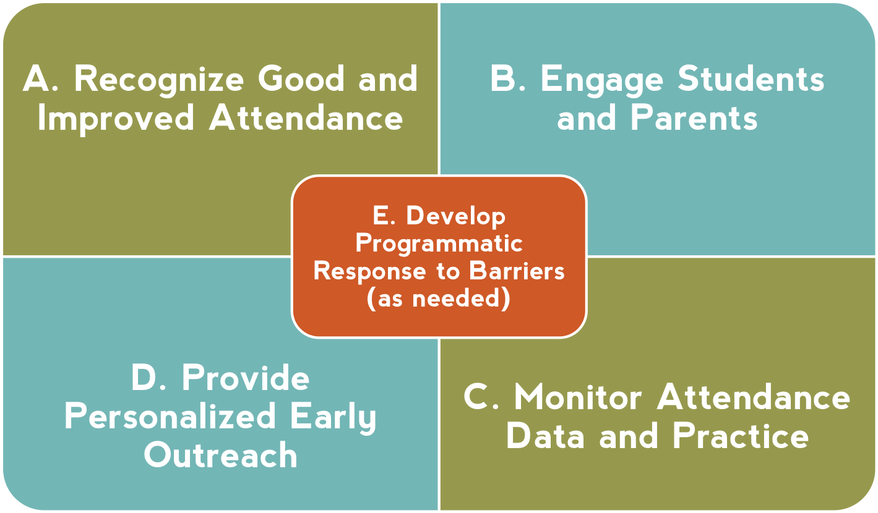
Universal Strategies for Building a Culture of Attendance & Identifying Barriers
Notes:
At same time, we know schools and communities can understand why kids aren’t in school and turn attendance around when they implement these five strategies with fidelity. How schools carry them out can be tailored to their own realities and strengths.
Then – I go through and offer examples of what each one of these might look like. I also clarify that recognizing good and improved attendance isn’t just providing perfect attendance awards for a semester or year– which doesn’t help to motivate improvement among the students with the most problematic attendance.

Slide 19
Increased Attendance Involves a 3-Tiered Approach that Fits with Most Reform Efforts
High Cost
Recovery
Programs
Students who were chronically
absent in prior year or
starting to miss 20%
or more of school
A small fraction
of a school’s
students
Intervention
Programs
Students at risk for
chronic absence
Some
of a school’s
students
Universal/Preventive
Programs
All students
in the school
All of
a school’s
students
Low Cost
Notes:
Improving attendance requires a 3 tiered approach. The challenge is that too many schools and communities are failing to invest in the first two tiers of universal and preventative. The strategies we just outlined– help to ensure an investment in the bottom two tiers – recognizing good and improved attendance as well as parent and student engagement are part of universal approaches. Personalized early outreach ensures intervention happens early. Investing in these bottom tiers is both more effective and less costly. And, if schools don’t, then the top of the pyramid becomes easily becomes overwhelmed.

Slide 20
Variation Across Schools Helps Identify Good Practice and Need for Intervention
Chronic Absence Levels Among Oakland Public Schools
(2009-10)
Notes:
Looking at data district wide is essential because it shows where we need to intervene because levels are extremely high. Consider the 9 elementary, 4 middle schools and 9 high schools with over 20% of their students who are chronically absent!! Something needs to happen differently in the schools.

Slide 21
Ingredients for System-wide Success & Sustainability
Community
District
Conveys why building a habit of attendance is important and what chronic absence is
Is accurate, accessible, and regularly reported
Positive Messaging
Actionable Data
Schools
Students & Families
Shared Accountability
Capacity Building
Ensures monitoring & incentives to address chronic absence
Expands ability to interpret data and work together to adopt best practices
Strategic partnerships between district and community partners address specific attendance barriers and mobilize support for all ingredients
Notes:
At same time, we know schools and communities can understand why kids aren’t in school and turn attendance around when they implement these five strategies with fidelity. How schools carry them out can be tailored to their own realities and strengths.
Then – I go through and offer examples of what each one of these might look like. I also clarify that recognizing good and improved attendance isn’t just providing perfect attendance awards for a semester or year– which doesn’t help to motivate improvement among the students with the most problematic attendance.

Slide 22
The Superintendents Call to Action
Own the Issue
Mobilize the Community
Drive With Data
To sign-up for the Call to Action, or to learn more, please visit: www.attendanceworks.org/superintendents-call-to-action
Notes:
If your district could use help with this work or would like to be kept informed of the latest tools and strategies, please encourage your superintendent to sign on to our Call to Action. If they do, they and their designated contacts, will automatically receive emails with resources and we create materials aimed at helping district administrators.
We also would like Superintendents to sign on – because it helps us make the case to state and federal officials that addressing chronic absence is an issue that has support and traction on the ground. It helps us advocate that they should help to provide needed capacity building and technical assistance resources.

Slide 23
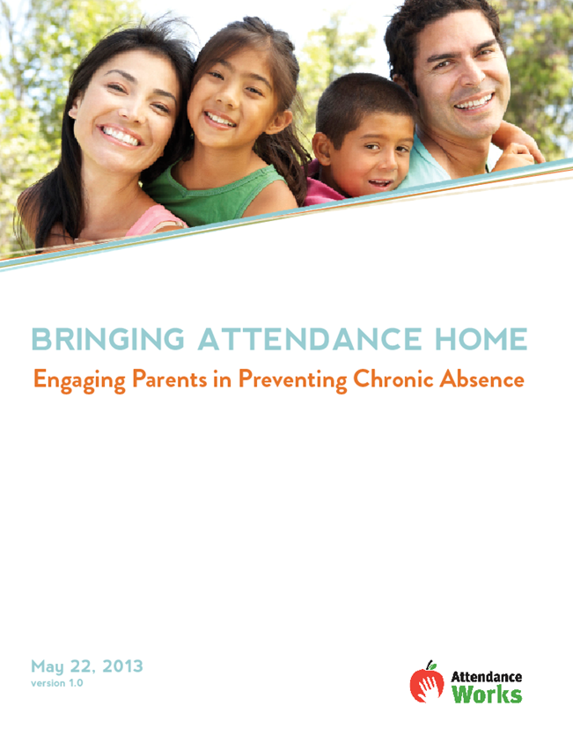
Using September to Promote Attendance Awareness
http://www.attendanceworks.org/attendancemonth/

Slide 24
Key Messages
Key Message #1: Good attendance helps children do well in school and eventually in the work place.

Slide 25
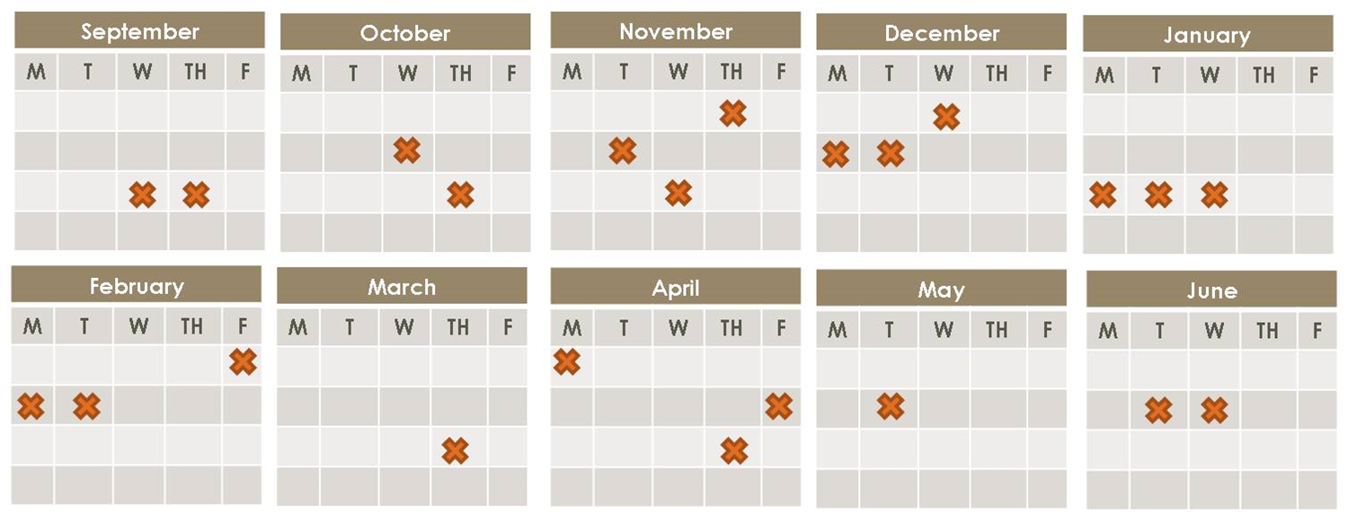
Key Messages
Key Message #2: Absences add up. Excused and unexcused absences result in too much time lost in the classroom.

Slide 26
Key Messages
Key Message #3: Chronic absence, missing 10 percent of the school year or more, affects the whole classroom, not just the students who miss school.

Slide 27
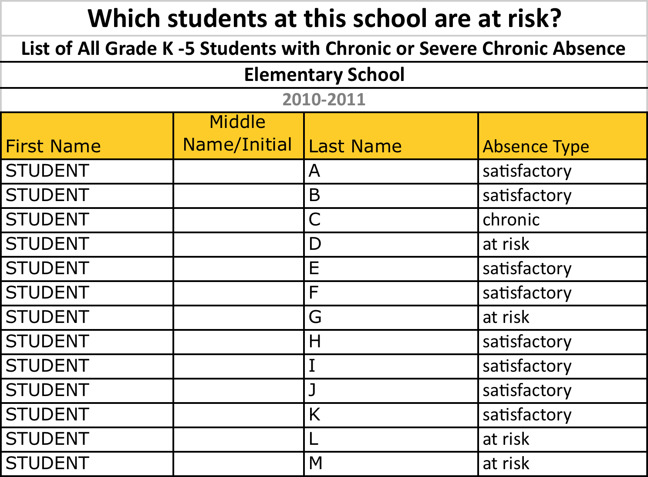
Key Messages
Key Message #4: We need to monitor how many days each student misses school for any reason — excused, unexcused or suspensions — so we can intervene early.

Slide 28
Key Messages
Key Message #5: Chronic absence is a problem we can solve when the whole community, including parents and schools, gets involved.

Slide 29
Key Messages
Key Message #6: Relationship building is fundamental to any strategy for improving student attendance.

Slide 30
Key Messages
Key Message #7: Reducing chronic absence can help close achievement gaps.

Slide 31
Chronic Absence = The Warning Light On A Car Dashboard
The Parallels
Ignore it at your personal peril!
Address early or potentially pay more (lots more) later.
The key is to ask why is this blinking? What could this mean?

Slide 32
Notes:
Thank you so much for taking the time to listen to this overview. We encourage you to refer to our web-site for additional resource or feel free to contact any member of the Attendance Works team. We appreciate your interest and commitment to improving student attendance so very child has the opportunity to learn, succeed and thrive.

